Slide 1

i-UPSHIFT Program

Slide 2

Innovation

Slide 3
Innovation can be defined as:
“developing a new solution or way of doing something that drives differentiation and creates measurable value”
*Innovation and entrepreneurship are two different things. Entrepreneurship is pursuing opportunities (often not necessarily based on innovation) without regard to the resources directly and currently controlled.

Slide 4
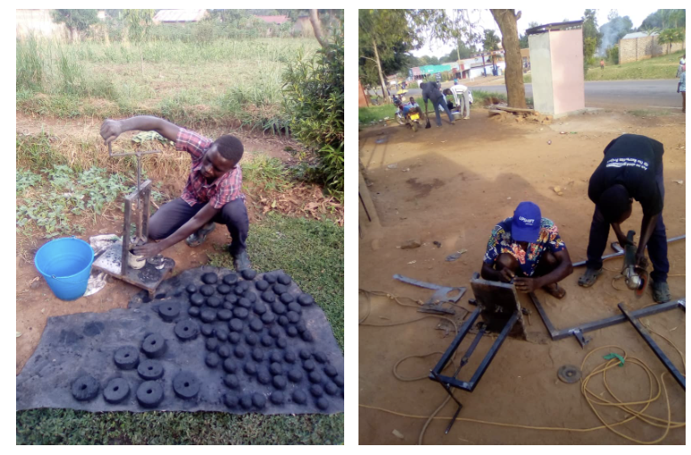
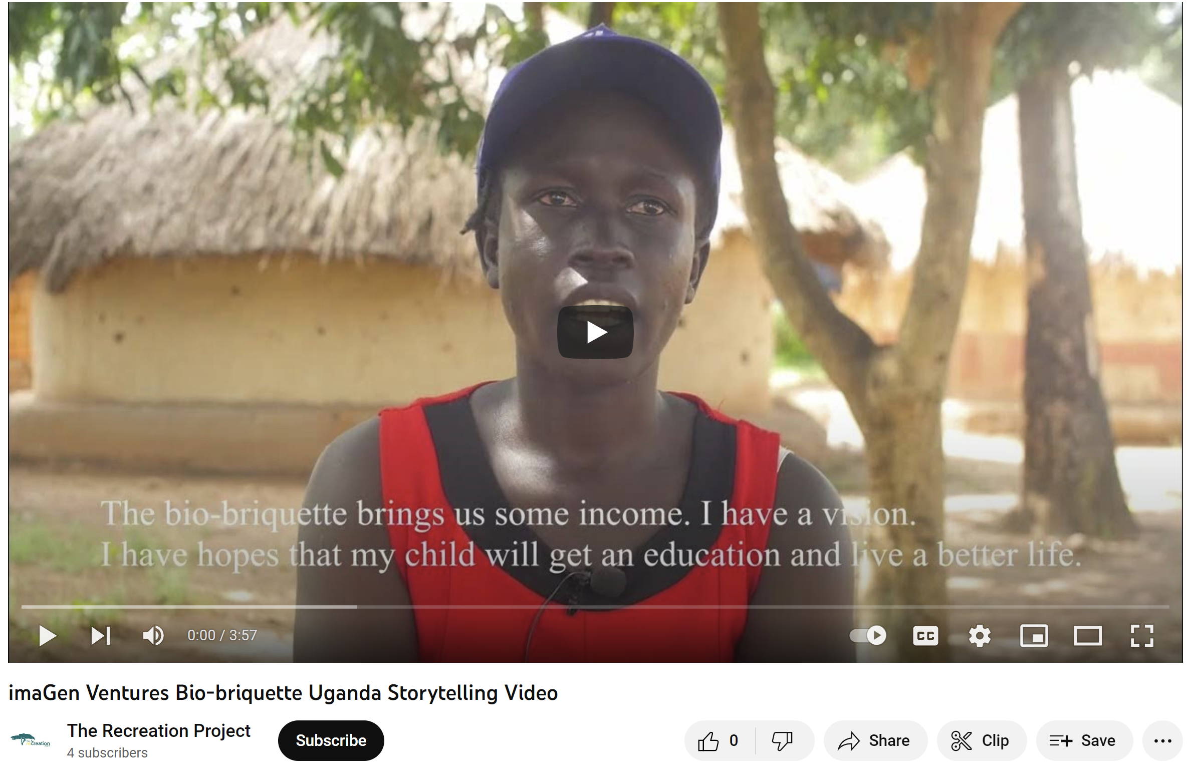
What is innovation – example#1
Averting deforestation by producing bio-briquette using upcycled wastes (Uganda)
Core problem: Community households experiencing deforestation
Main cause: Tree-cutting to produce charcoal
Main effect: Reduced productivity in farming leading to lower household income
Goal: Prevent community from being affected by deforestation by stopping tree-cutting to produce charcoal
Solution: Production of bio-briquette through household waste upcycling
imaGen Ventures Bio-briquette Uganda Storytelling Video - YouTube

Slide 5
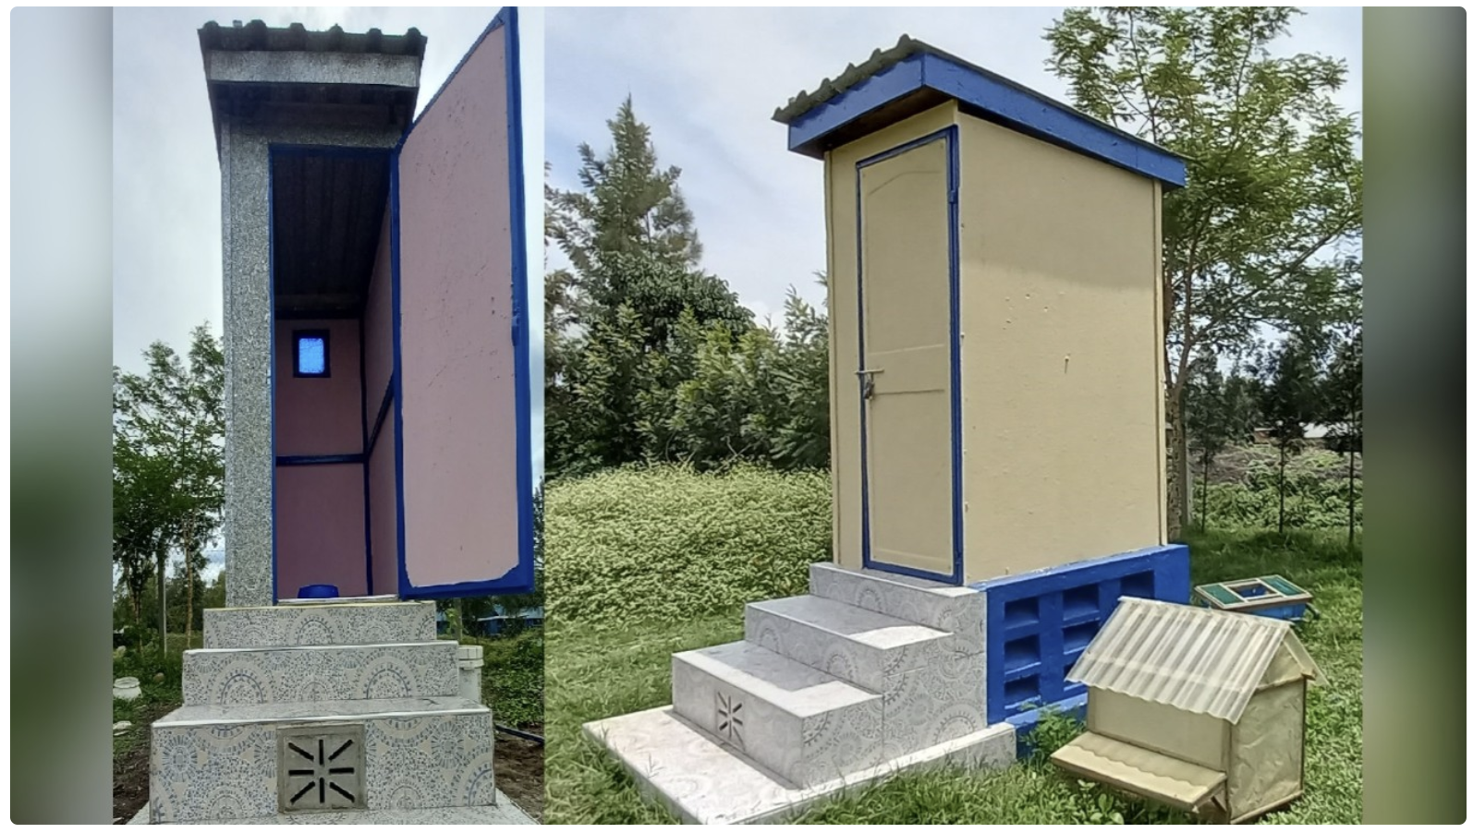
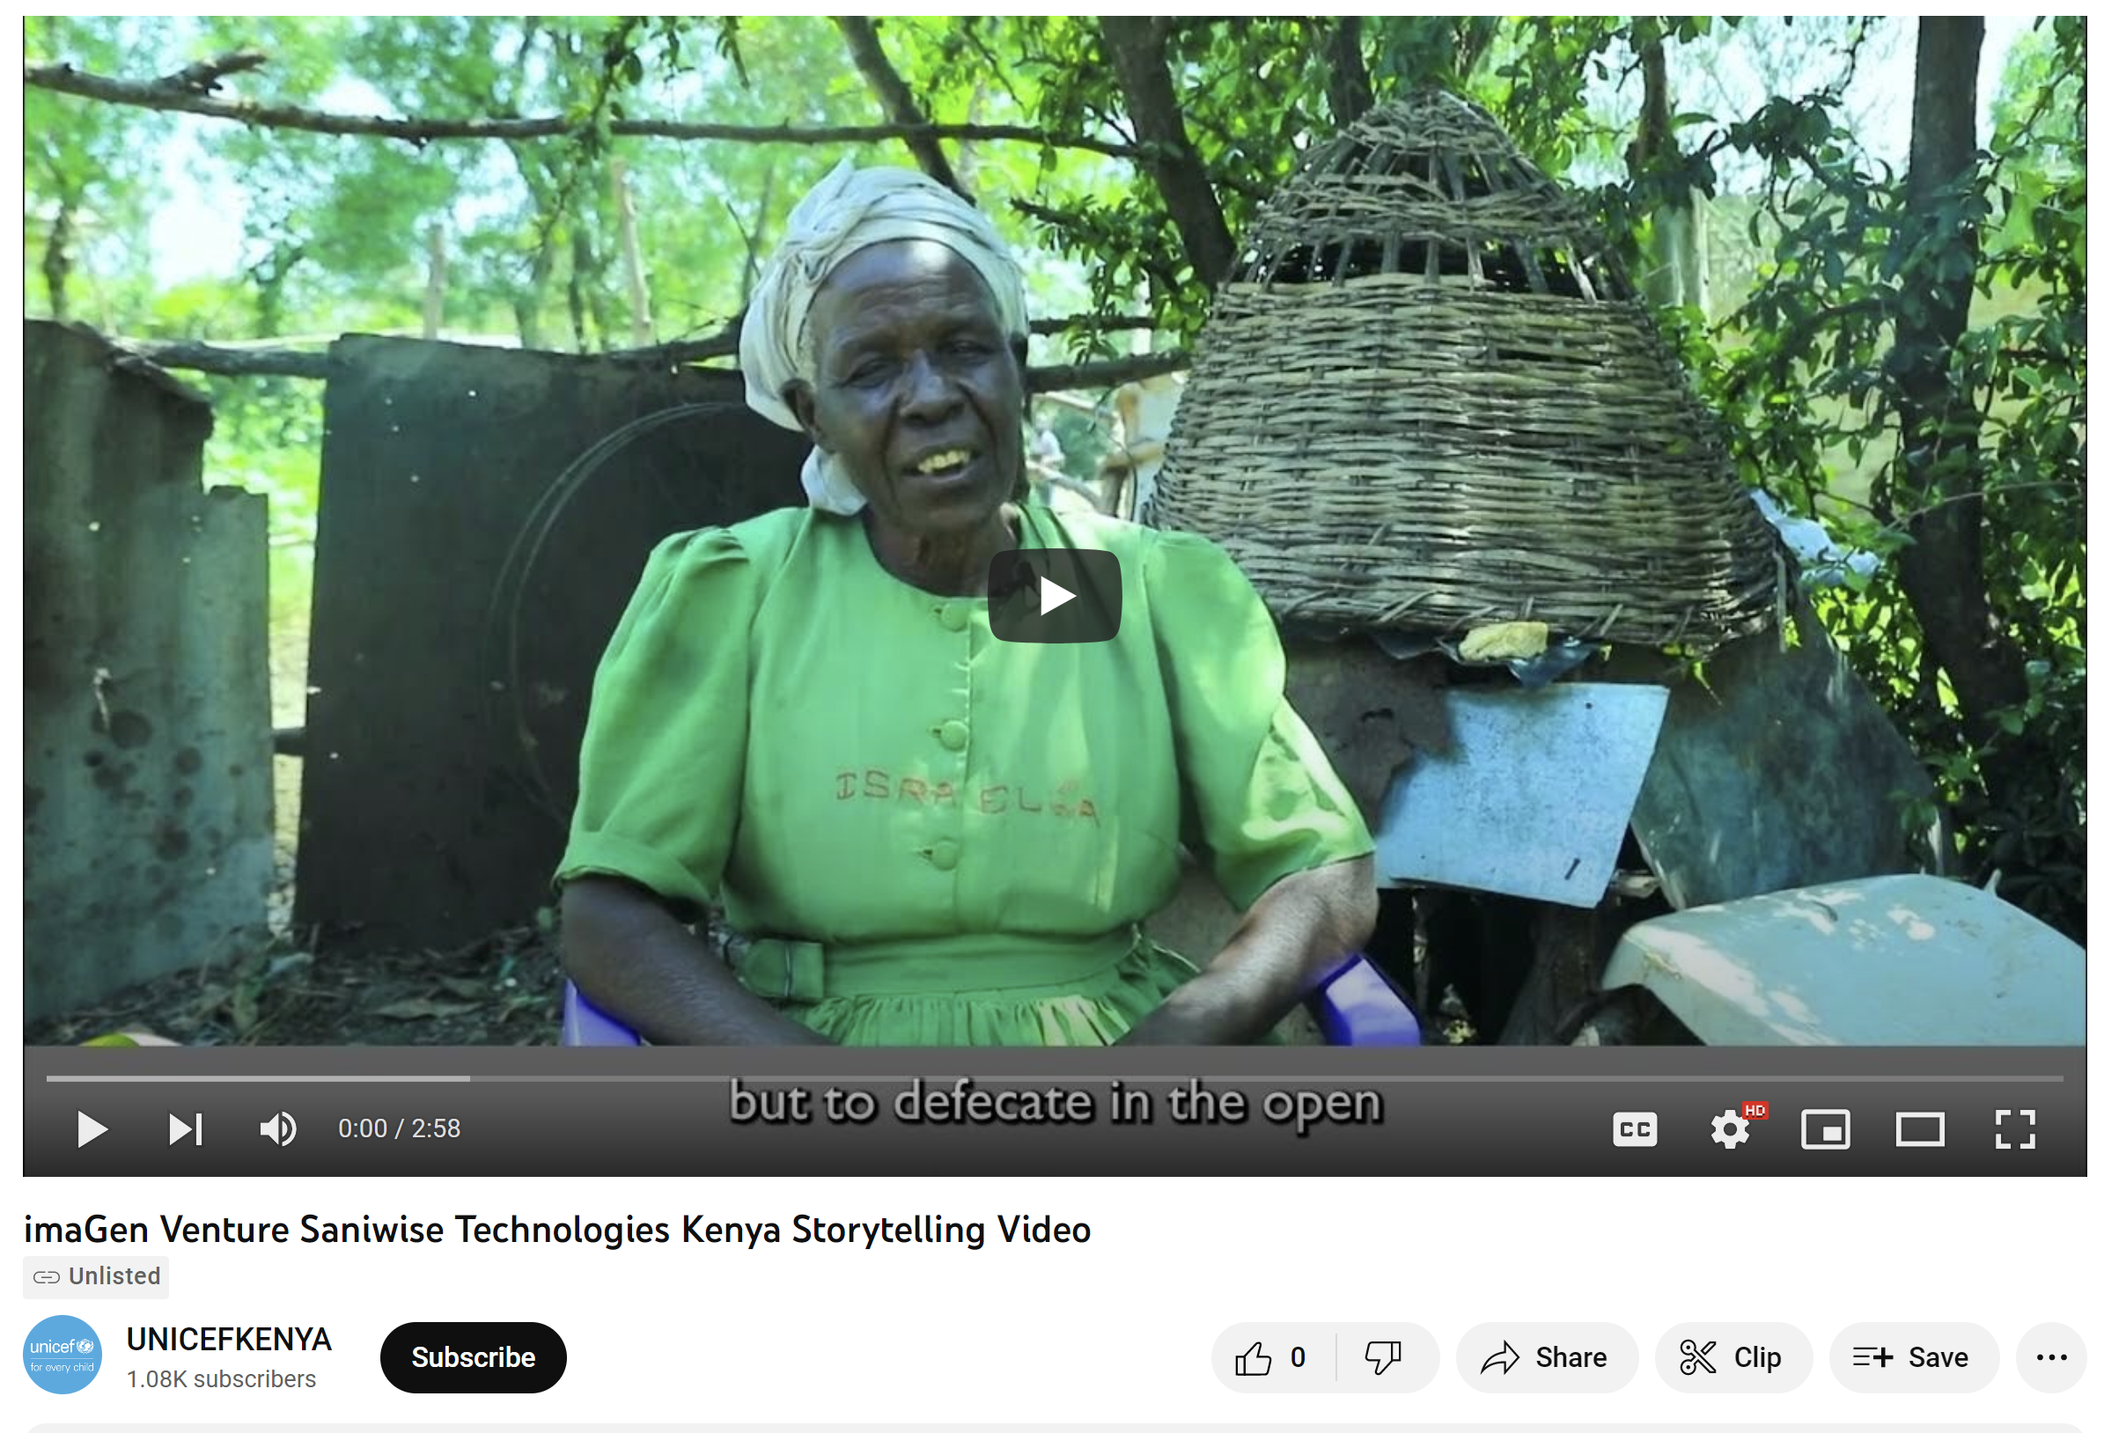
What is innovation – example#2
Saniwise Toilet : promoting health and agriculture fertilizers in informal settlements (Kenya)
Core problem: Community members keep practicing open defecation
Main cause: Low accessibility to proper, safe and affordable sanitation
Main effect: High risk in environment and public health including sanitation related diseases
Goal: Prevent community from being practicing open defecation by increasing their accessibility to sanitation
Solution: Production of cost-effective, bio-resource based toilet by using recycled plastics and green design
imaGen Venture Saniwise Technologies Kenya Storytelling Video - YouTube

Slide 6
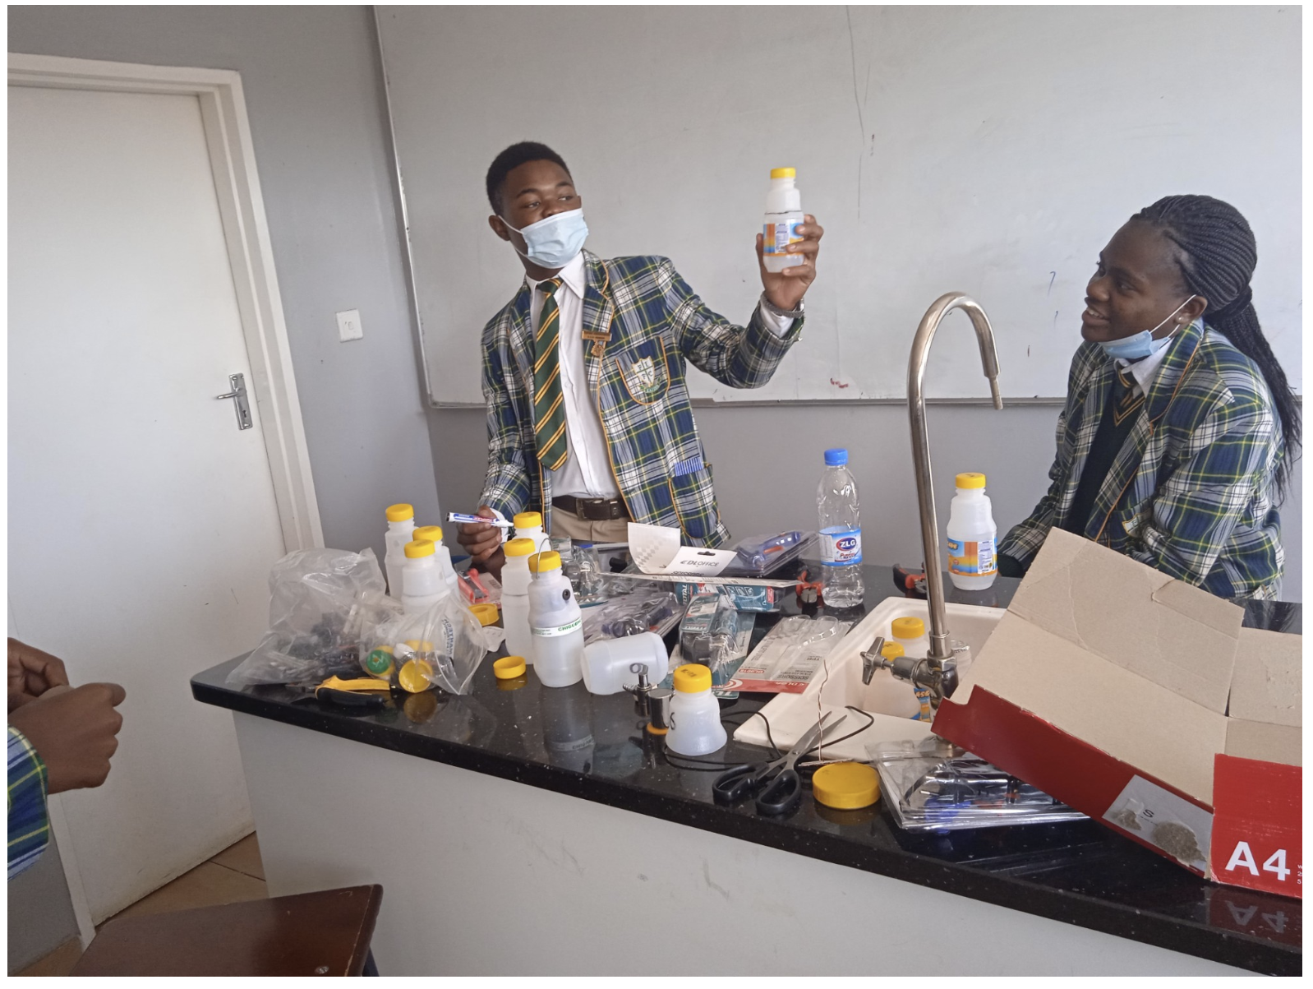
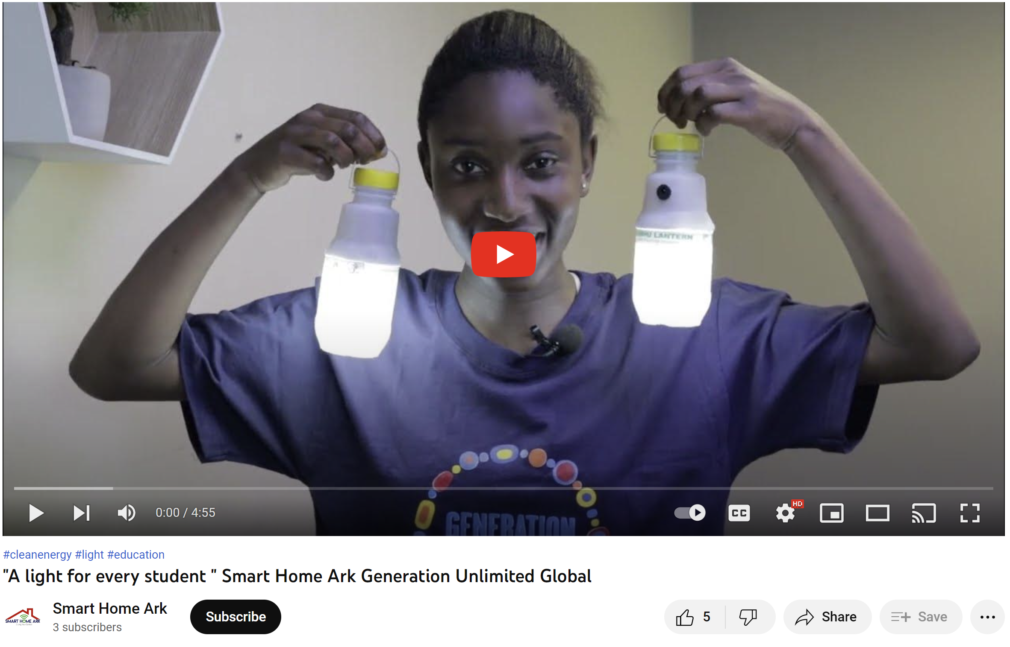
What is innovation – example#3
Off-grid lighting using recycled products (Zimbabwe)
Core problem: Children having poor access to lighting in schools and residential buildings
Main cause: Low electrification rates in the region
Main effect: Many students relying on lighting sources that have negative impacts on health, environment and economy
Goal: Prevent children from getting negative impacts on health by increasing electrification rates
Solution: Production of cost-effective off-grid solar powered Direct Current LED lighting system
"A light for every student " Smart Home Ark Generation Unlimited Global - YouTube

Slide 7
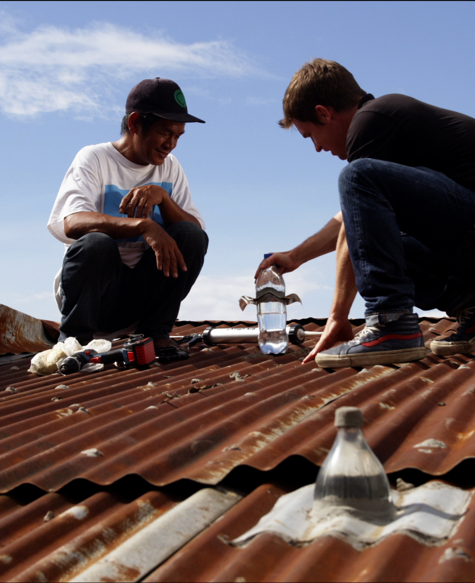
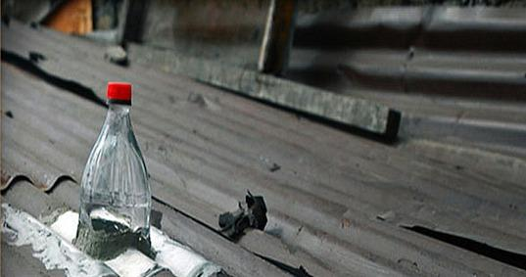
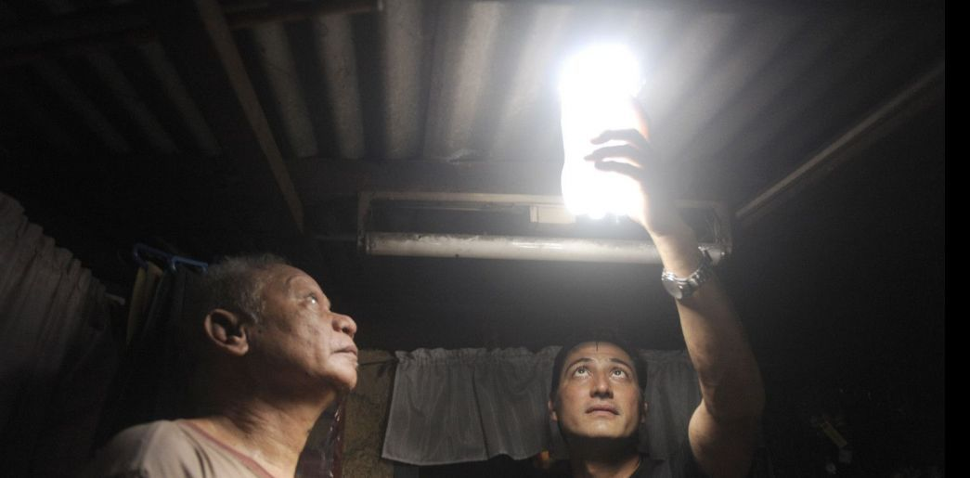
Litre of light creates local lighting solutions based on real problems and needs of people in urban settlements in Philippines.
Impact - Helps bring lighting to poor homes with cheap and easily available materials.
Notes:
Sometimes the social impact can be brought about by a small product idea.

Slide 8
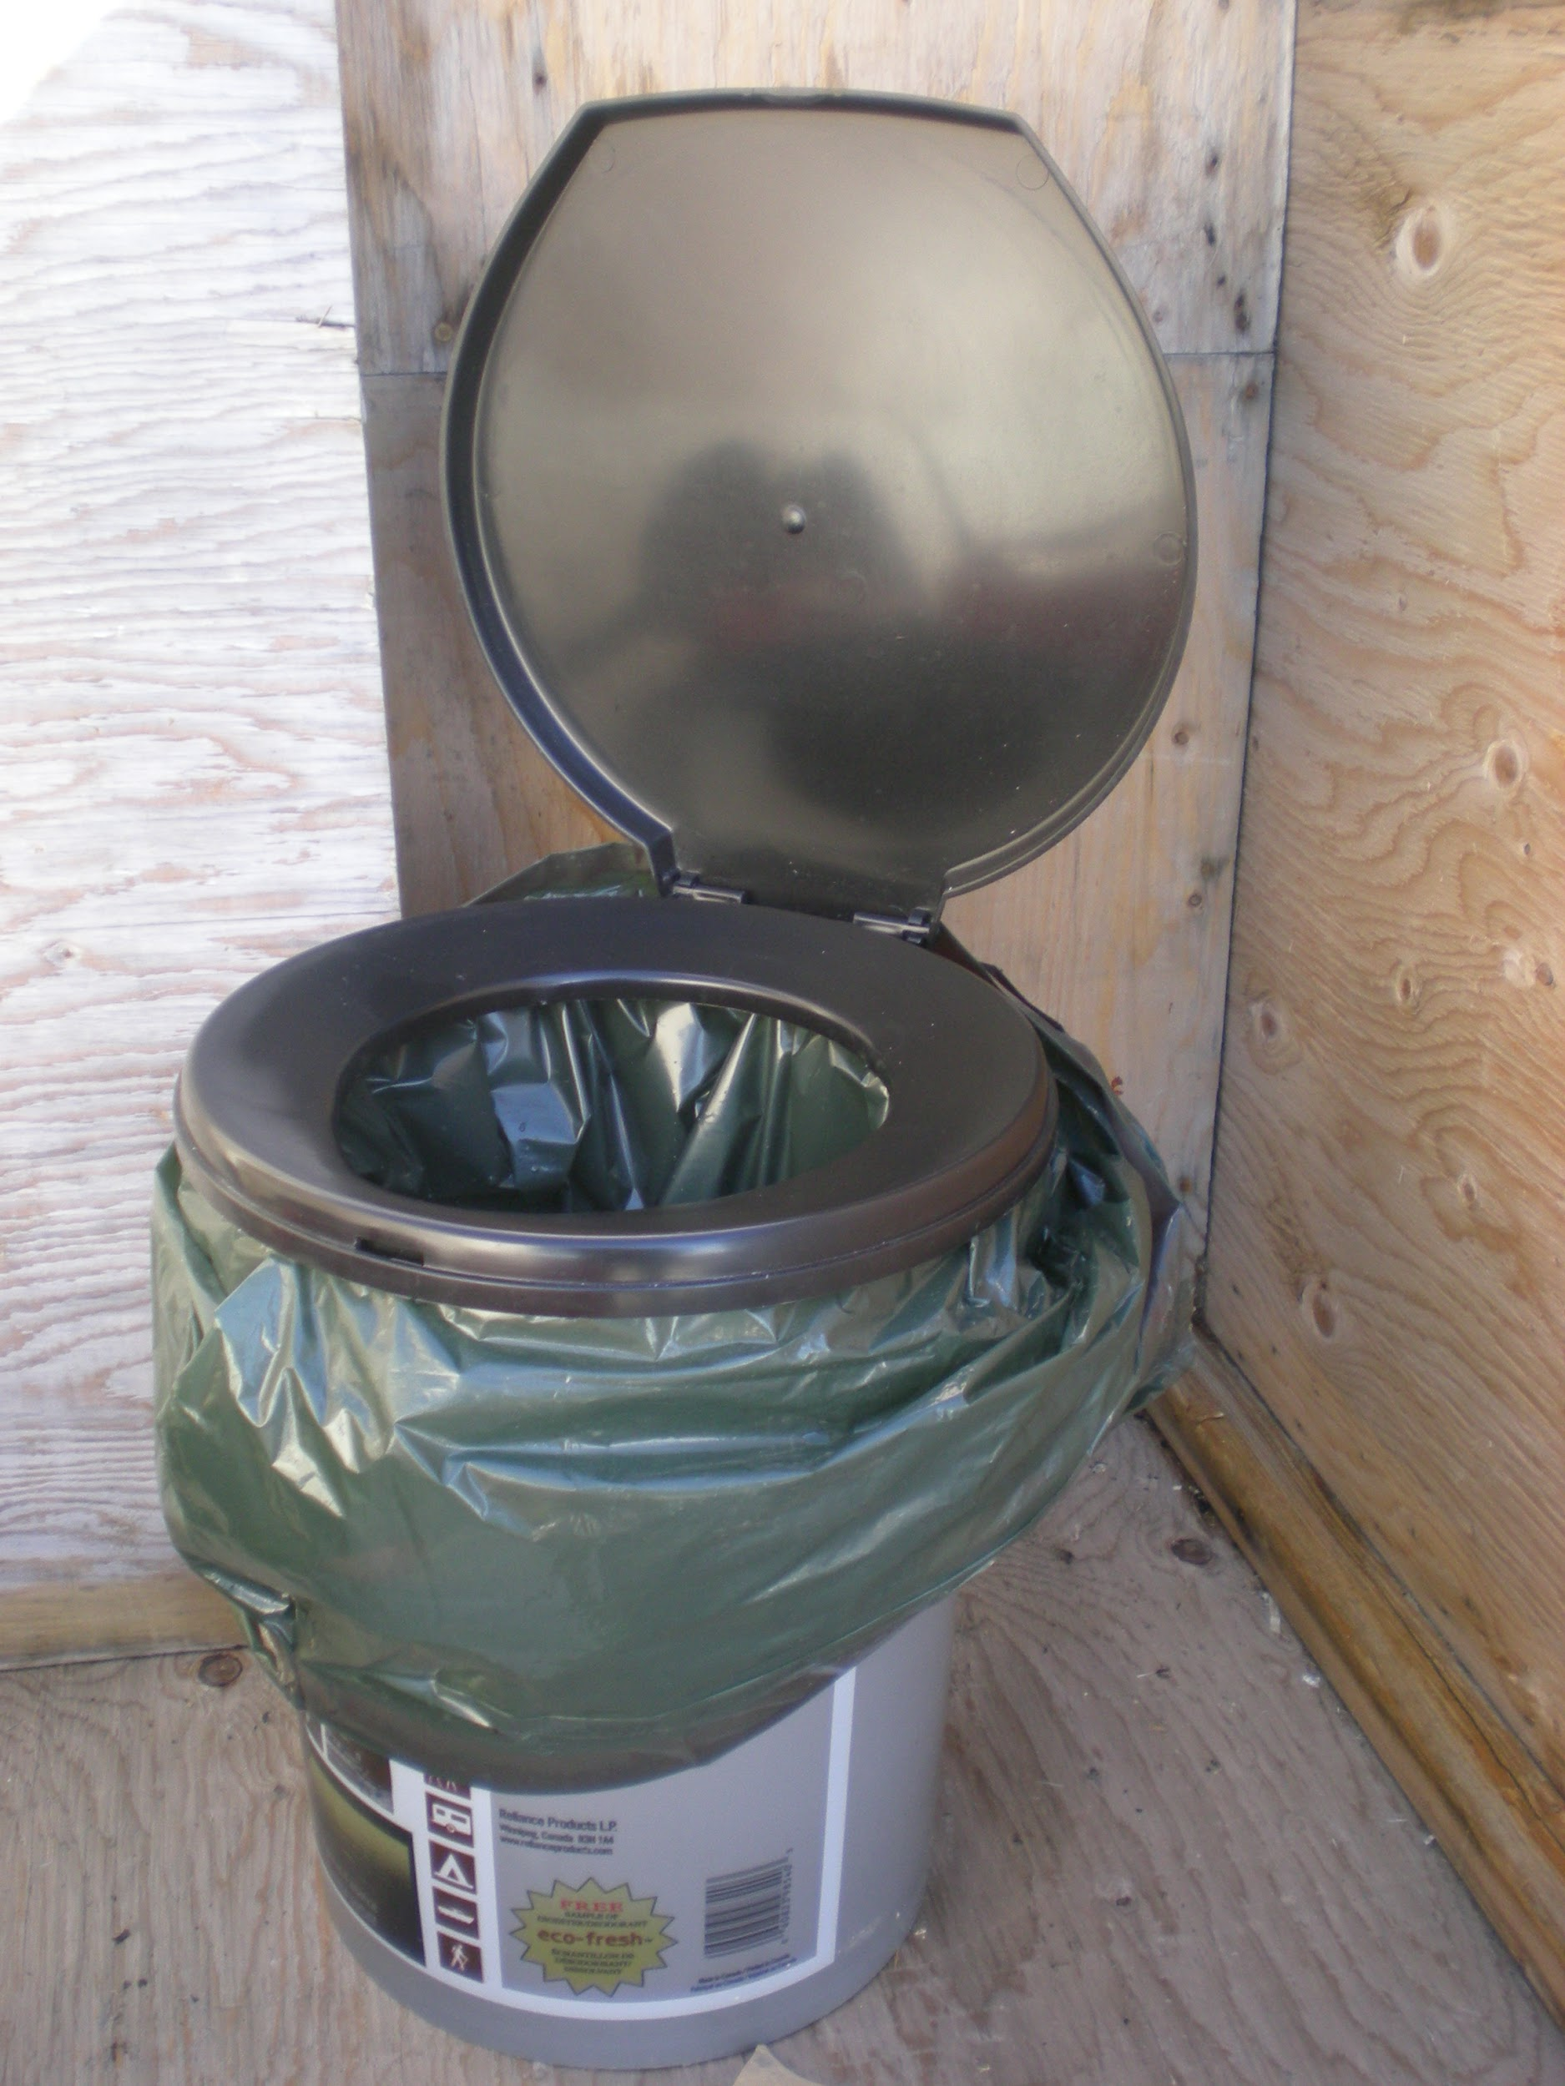

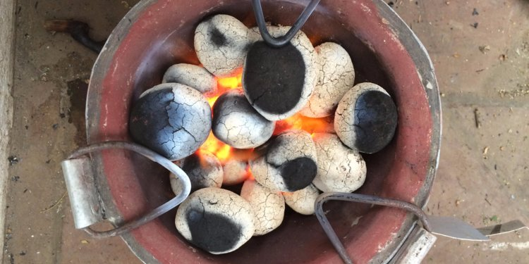
Sanivation in Kenya, creates portable toilets, collects waste that can be used to create fuel briquettues to cook food.
Impact - The Toilet bucket reduces open defecation, and hence transmission of diseases, while the briquettes made from the refuse, generates additional revenue for the organisation.
Notes:
Sometimes the social impact can be brought about by service.

Slide 9
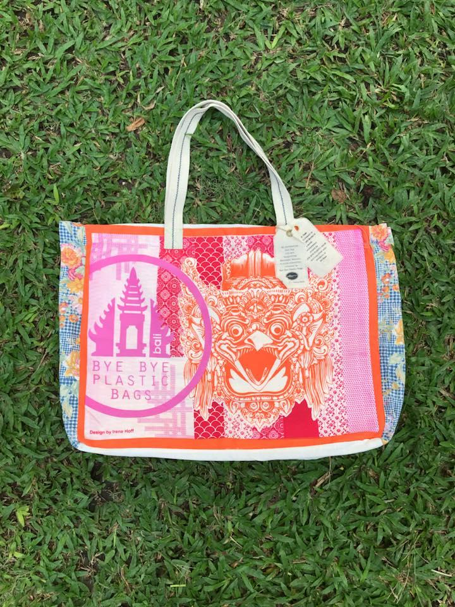


Bye Bye plastic bags uses activism and recycled products to make locals aware of plastic pollution in the small island of Bali.
Impact - Their work led to the ban of plastic bags in Bali by the governer, and they hold ocean clean ups through their volunteer groups.
Notes:
Sometimes the social impact can be brought about by a small product idea.

Slide 10
EXAMPLE CHALLENGE TOPIC
CLIMATE CHANGE

Slide 11


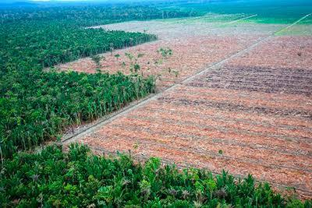
Climate change (CAUSES)

Slide 12
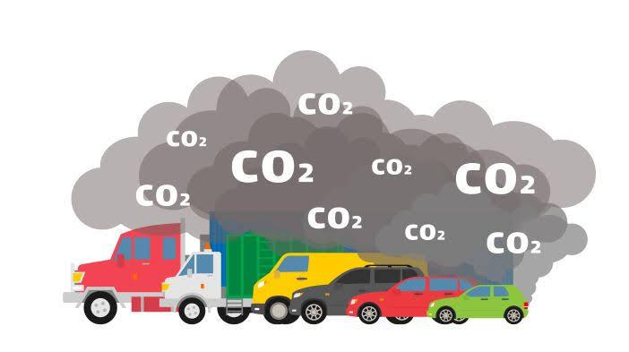
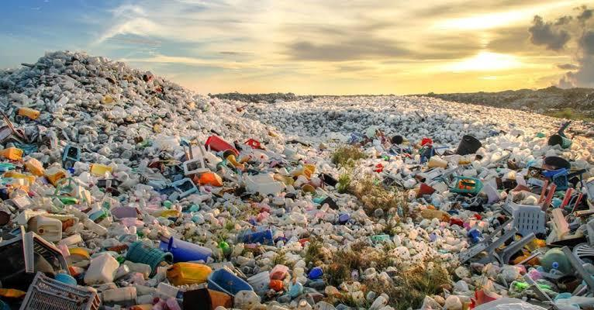
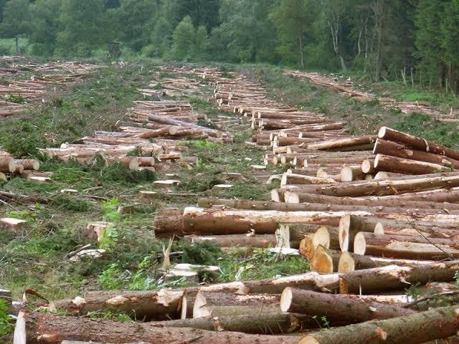
Climate change (CAUSES)

Slide 13


Slide 14
How could we address the causes or effects of climate change in our communities?
Notes:
Reduction, Prevention, Solving challenges of child mothers? Let the teams to define.

Slide 15
PHASE 1
OBSERVE + UNDERSTAND

Slide 16
PHASE 1: OBSERVE + UNDERSTAND
Better understand the social problem we are trying to solve, and who we are trying to help.

Slide 17

What we see
(Problematic situation)
Notes:
Understanding a problem and its consequences helps us look for ways to lessen or eliminate impact of the problem, and understanding the causes might let us address the cause and eliminate the problem altogether!

Slide 18
What we see
(Problematic situation)
What we don’t see
(The real problem)
Notes:
Understanding a problem and its consequences helps us look for ways to lessen or eliminate impact of the problem, and understanding the causes might let us address the cause and eliminate the problem altogether!

Slide 19
A THOROUGH UNDERSTANDING OF A PROBLEM HELPS US BUILD MORE SUCCESSFUL SOLUTIONS.
Notes:
By ensuring our solutions are relevant & impactful (needed – solve a real problem for real people)

Slide 20
PHASE 1: OBSERVE + UNDERSTAND | Activity 1-1
WHAT IS THE PROBLEM?
Problem Tree + 5 Whys
Notes:
3-5 min discussion. NOTE: This early in the workshop, team members may be hesitant to speak up. Help the team communicate their thoughts by asking probing questions.
-By ensuring our solutions are relevant & impactful (needed – solve a real problem for real people)

Slide 21
PHASE 1: OBSERVE + UNDERSTAND | Activity 1-1
PROBLEM TREE
Explore the effects and causes of a problem to understand it better.
Notes:
By ensuring our solutions are relevant & impactful (needed – solve a real problem for real people)

Slide 22

PHASE 1: OBSERVE + UNDERSTAND | Activity 1-1
PROBLEM TREE
What we see
(Problematic situation)
Notes:
Fortunately, there are simple tools and techniques we can use to access a more complete understanding of the cause of a problem (where we might intervene to prevent the problematic situation from arising or occurring) and its consequences (which we might seek to mitigate if we are unable to impact the root causes).
A problem tree can be an effective tool for mapping out problems, and helps us identify and understand both effects (consequences) and causes

Slide 23
PHASE 1: OBSERVE + UNDERSTAND | Activity 1-1
PROBLEM TREE
What we see
(Problematic situation)
What we don’t see
(The real problem)
Notes:
Fortunately, there are simple tools and techniques we can use to access a more complete understanding of the cause of a problem (where we might intervene to prevent the problematic situation from arising or occurring) and its consequences (which we might seek to mitigate if we are unable to impact the root causes).
A problem tree can be an effective tool for mapping out problems, and helps us identify and understand both effects (consequences) and causes

Slide 24
PHASE 1: OBSERVE + UNDERSTAND | Activity 1-1
PROBLEM TREE
EFFECTS
Write down all the consequences of the problem on the branches of the tree. Place each consequence on a different branch.
PROBLEM
Write down your core problem in the ‘trunk’ of the tree.
CAUSES
Attach the causes of the problem to the roots of the tree.
Notes:
Just as a tree has 3 separate parts – roots/trunk/branches – so too can a problem be divided into its 3 parts: Core problem (trunk), causes (roots) and effects/consequences (branches)

Slide 25
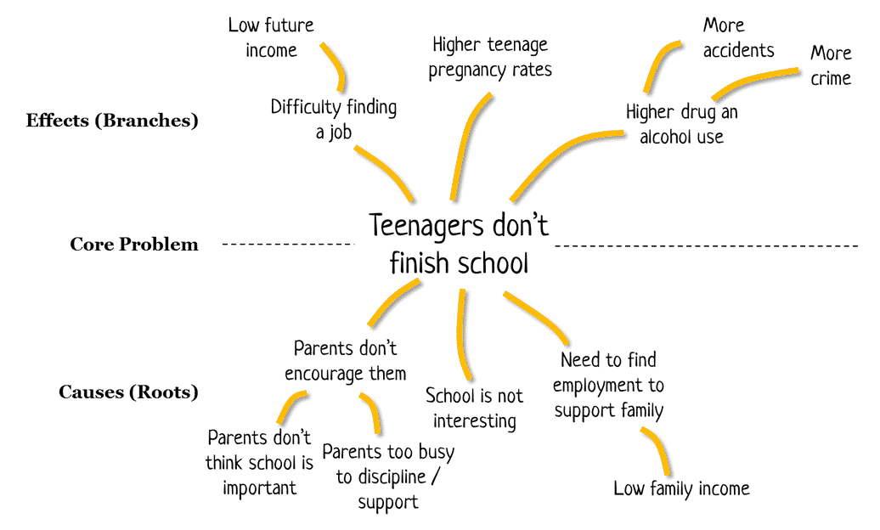
PHASE 1: OBSERVE + UNDERSTAND | Activity 1-1
PROBLEM TREE - EXAMPLE

Slide 26
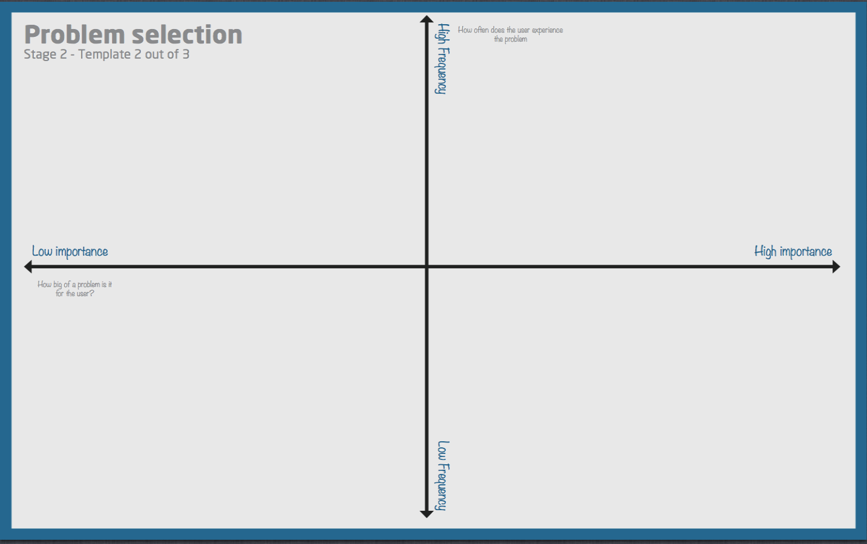

Slide 27
PHASE 1: OBSERVE + UNDERSTAND | Activity 1-1
5 WHYs?
Go deeper into the causes of the problem, and pick the ones to focus on to solve.
Notes:
By ensuring our solutions are relevant & impactful (needed – solve a real problem for real people)

Slide 28
PHASE 1: OBSERVE + UNDERSTAND | Activity 1-1
5 WHYs?
The answer to asking ‘Why?’ as a question only once can be superficial.
While these answers may be true, often they are only part of the story, and aren’t helpful to those that are attempting to create solutions, which is the reason we ask ‘WHY’ many times.

Slide 29


PHASE 1: OBSERVE + UNDERSTAND | Activity 1-1
5 WHYs?
CAUSES
Notes:
Fortunately, there are simple tools and techniques we can use to access a more complete understanding of the cause of a problem (where we might intervene to prevent the problematic situation from arising or occurring) and its consequences (which we might seek to mitigate if we are unable to impact the root causes).
A problem tree can be an effective tool for mapping out problems, and helps us identify and understand both effects (consequences) and causes

Slide 30
PHASE 1: OBSERVE + UNDERSTAND | Activity 1-1
5 WHYs?
Question example
Why is there increased draught? One reason is because there’s hotter atmospheric temperature
Why is there hot temperature? One reason is because they generate electricity by burning fossil fuels and also carbon dioxide gas emissions from transport
Why transportation carbon dioxide gas emissions? Because 94% of fuel used in transportation is petroleum based
Why petroleum fuel? One reason is because most of the transport means are designed to consume fuel due to its high energy value per unit volume
Why do manufacturers choose to make petroleum fuel vehicles? One reason is because the electric vehicle (EV) industry is still in it’s early technology stage

Slide 31
PHASE 1: OBSERVE + UNDERSTAND | Activity 1-1
5 WHYs?
Do this exercise for one or two main causes you have written down on the roots of the tree, so that you have a good understanding of the causes of the root problem.

Slide 32
PHASE 1: OBSERVE + UNDERSTAND | Activity 1-2
WHO IS INVOLVED?
Stakeholder Mapping + Target Groups

Slide 33
PHASE 1: OBSERVE + UNDERSTAND | Activity 1-2
STAKEHOLDER MAP + TARGET GROUPS
Identify the people who are involved with the problem.

Slide 34
PHASE 1: OBSERVE + UNDERSTAND | Activity 1-2
STAKEHOLDER MAP +
TARGET GROUPS
Target Stakeholders directly experiences the problem
Indirect Stakeholders are people who could be motivated to support or participate in change.
TARGET
INDIRECT
Other people or groups who are connected to the problem and are trying to solve it.
OTHERS

Slide 35





PHASE 1: OBSERVE + UNDERSTAND | Activity 1-2
STAKEHOLDER MAP +
TARGET GROUPS
public figures, celebrities
NGOs
extended family
peers
parents
Local leaders
teachers
siblings
Children
Partner
(social media)
Problem:
Children keep falling sick in rural area.
Youth clubs
media

Slide 36
PHASE 1: OBSERVE + UNDERSTAND | Activity 1-2
STAKEHOLDER MAP +
TARGET GROUPS
public figures, celebrities
NGOs
extended family
peers
parents
Local leaders
teachers
siblings
Children
Partner
(social media)
Problem:
Children keep falling sick in rural area.
Youth clubs
media

Slide 37
PHASE 1: OBSERVE + UNDERSTAND | Activity 1-3
HOW TO DO USER RESEARCH?
RESEARCH METHODS

Slide 38
PHASE 1: OBSERVE + UNDERSTAND | Activity 1-3
RESEARCH METHODS:
Understand the process of conducting research and gathering more information on your problem.

Slide 39
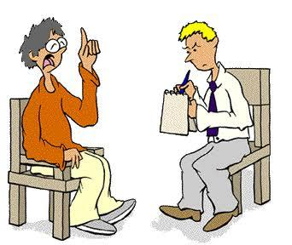


PHASE 1: OBSERVE + UNDERSTAND | Activity 1-3
USER RESEARCH METHODS:
Talk to people
Observation
Do it yourself

Slide 40
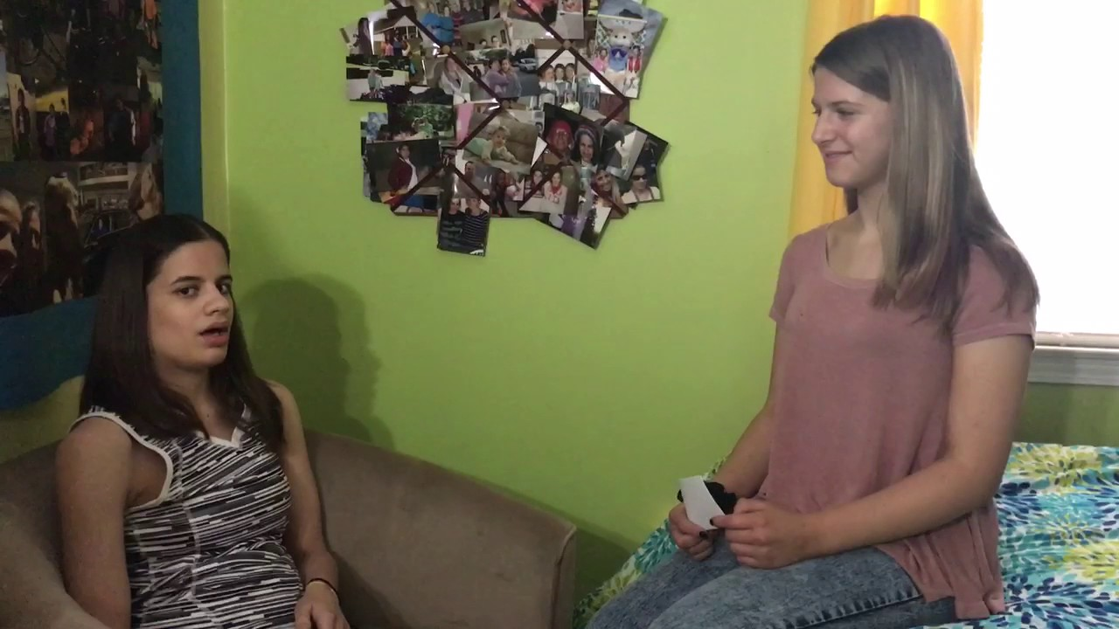
PHASE 1: OBSERVE + UNDERSTAND | Activity 1-3 | RESEARCH METHODS
1. TALK TO PEOPLE
This involves talking to target groups to understand how they see the problem.

Slide 41
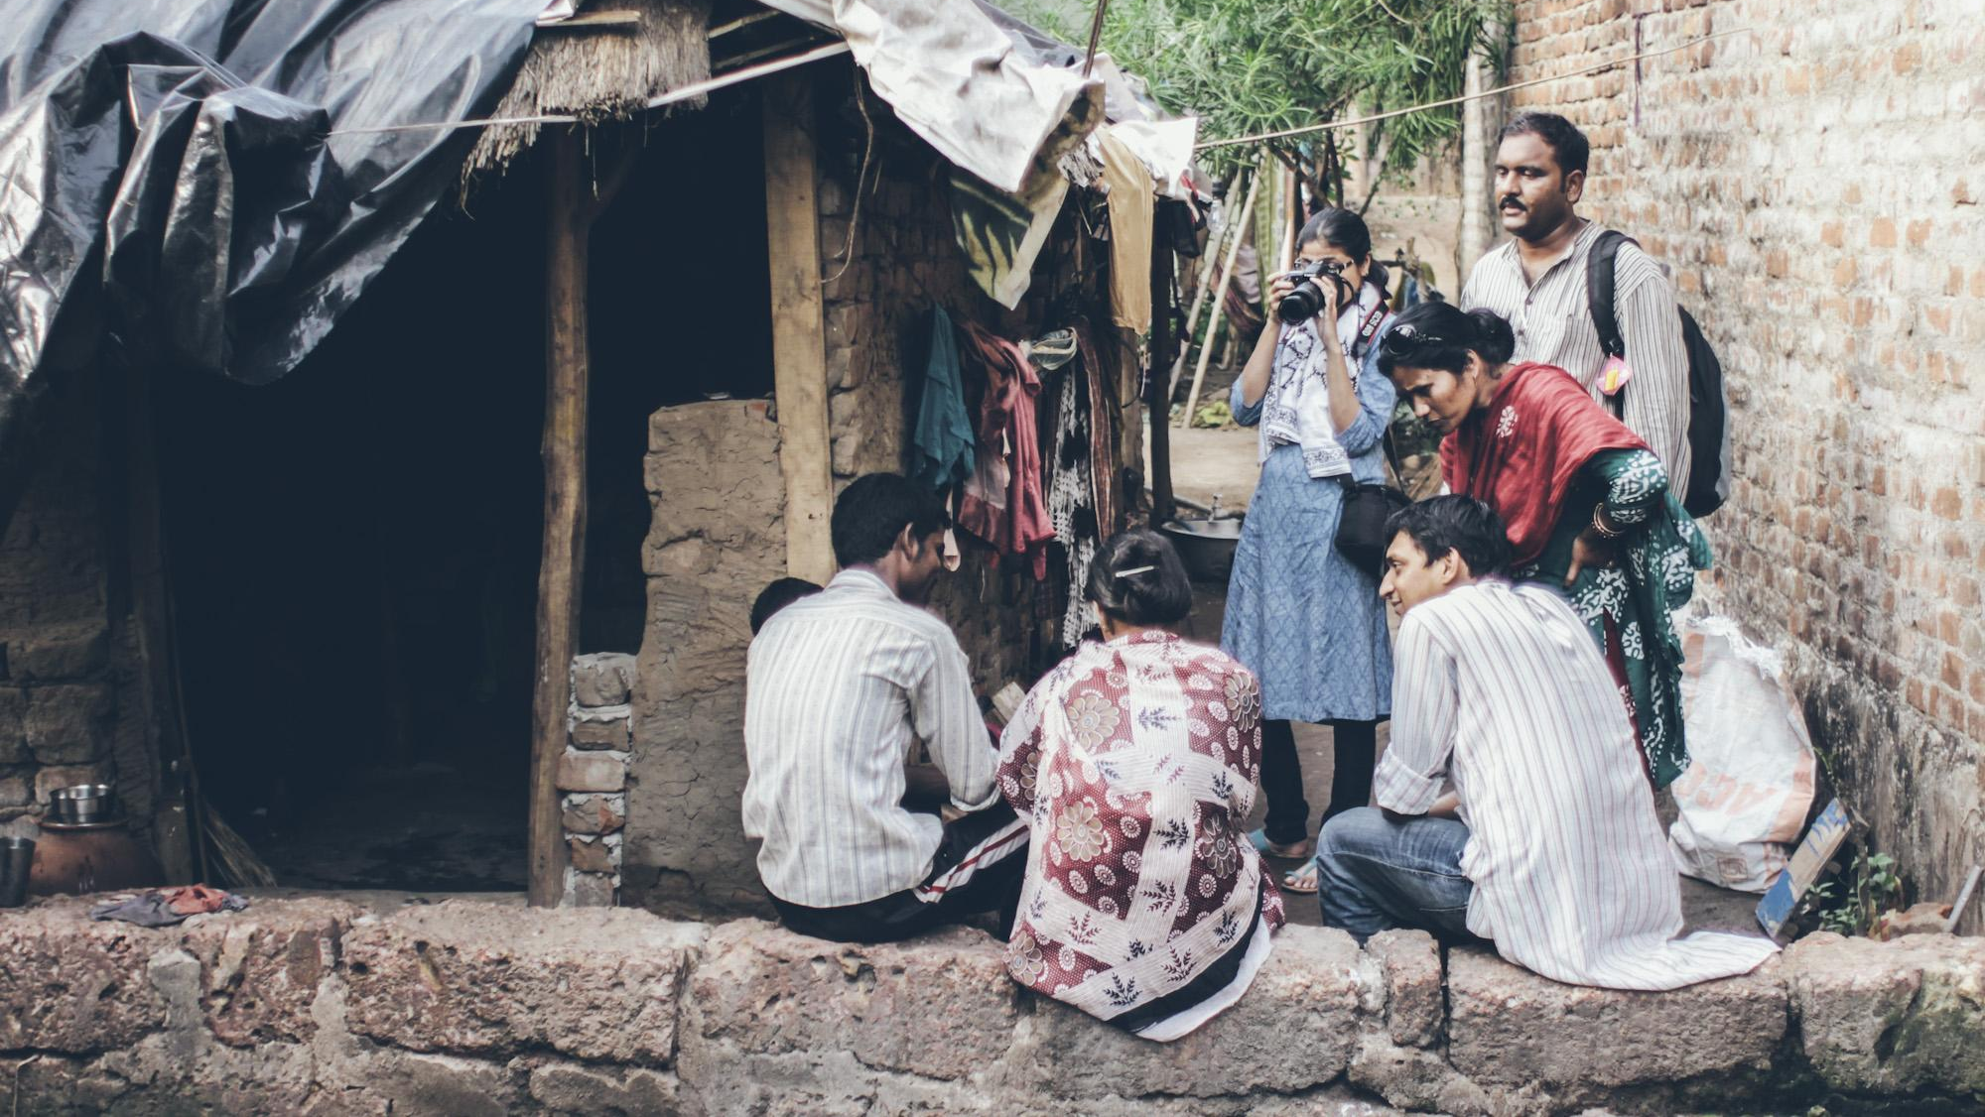
PHASE 1: OBSERVE + UNDERSTAND | Activity 1-3 | RESEARCH METHODS
2. OBSERVE PEOPLE
This involves observing people interacting with a situation to see all the different aspects of the problem.

Slide 42
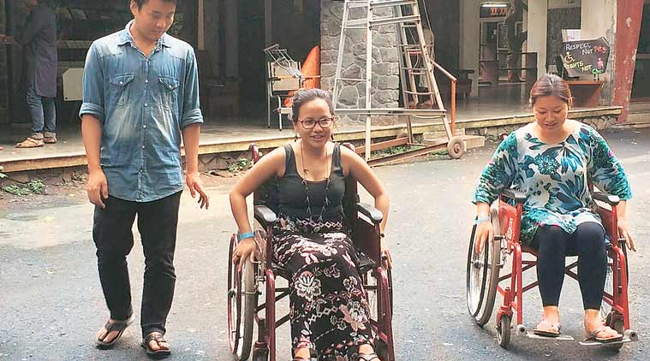
PHASE 1: OBSERVE + UNDERSTAND | Activity 1-3 | RESEARCH METHODS
3. DO IT YOURSELF
This involves experiencing the situation yourself, to better understand the other person’s point of view.

Slide 43
PHASE 1: OBSERVE + UNDERSTAND | Activity 1-4
CONDUCTING
USER RESEARCH
USER INTERVIEW + OBSERVATION

Slide 44
PHASE 1: OBSERVE + UNDERSTAND | Activity 1-4
HOW TO DO USER INTERVIEWS?
1
Identifying and recruiting interviewees
Talk to target users and other stakeholders to understand their needs, motivations and behaviors first hand.
From your stakeholder map, identify which groups are most closely connected to your problem.
2
Develop 3 to 5 interview questions
Questions should help us explore our assumptions; consider asking about things you think you already know about the problem.
Notes:
Explain that while identifying and recruiting interviewees the list should certainly include your target group, and may also include indirect beneficiaries or key stakeholders.
Encourage teams not to ask leading questions and to avoid yes/no questions. Explain that the goal is to have users tell us a story and that every question is a starting point. Also encourage them to use follow up questions to go deeper. Also add that questions should start broad and concrete (e.g. “Have you ever had a problem with [your problem]?”) and move to specific and abstract (e.g. “What motivated you to make that choice?”)

Slide 45
PHASE 1: OBSERVE + UNDERSTAND | Activity 1-4
CONDUCTING
USER RESEARCH
When developing 3 interview questions…
Try not to ask leading questions. A leading question encourages interviewees to give a certain kind of answer (e.g. Don’t ask “How angry were you?” Instead ask “How did that make you feel?”
Avoid yes/no questions – they don’t go anywhere!
The goal is to have users tell us a story. Every question is a starting point; you will use follow up questions to go deeper.
Questions should start broad and concrete (e.g. “Have you ever had a problem with [your problem]?”) and move to specific and abstract (e.g. “What motivated you to make that choice?”)

Slide 46
PHASE 1: OBSERVE + UNDERSTAND | Activity 1-4
HOW TO OBSERVE A PROBLEM?
1
Identifying what and who needs to be observed/experienced ?
From your stakeholder map, identify which groups and the locations / time in which they need to be observed.
To observe or personally experience the issue, by going to the environment or facing a similar situation.
2
Do it yourself
Personal experience can be one of the most powerful tools in gaining an understanding of an area and uncovering information. Visit the environment, use the tools or step into a process yourself to understand your users experience.
3
Record key observations
Record what you saw, did, thought or felt when you experienced the same situation as your user.
Notes:
Explain to the teams that the key with observation is to really take the time to look, and make note of what they see. This helps get a real understanding of the world from the perspective of the people they are solving a problem for. Note - draw out the observation recording template provided to you on the facilitation guide so the teams can systematically record their observations

Slide 47
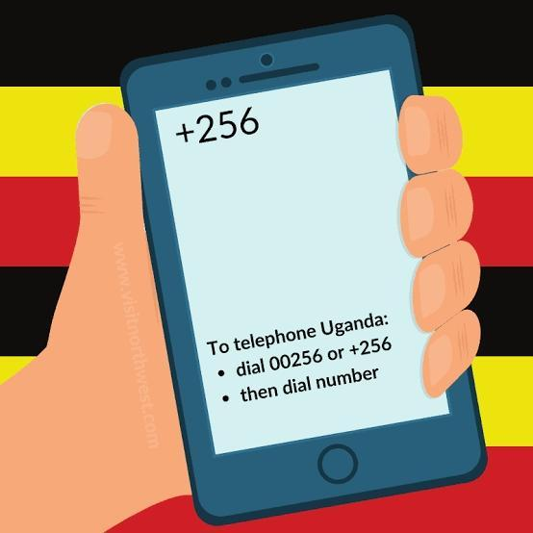
PHASE 1: OBSERVE + UNDERSTAND | Activity 1-4
CONDUCTING
USER RESEARCH
Let’s exercise!

Slide 48
PHASE 2
DESIGN

Slide 49
PHASE 2 : DESIGN
Reframe challenges in a way that invites new ideas, to come up with creative solutions.

Slide 50
PHASE 2 : DESIGN | Activity 2-1
WHO ARE YOU SOLVING FOR ?
Personas

Slide 51
PHASE 2: DESIGN | Activity 2-1
PERSONAS
Build empathy & understanding of those who are affected most by the problem.
Notes:
Have to ensure we define what empathy is.

Slide 52

PHASE 2: DESIGN | Activity 2-1
PERSONAS
Personas are fictional “characters” we create to represent a group of stakeholders, to create an emotional connection with them.

Slide 53
PHASE 2: DESIGN | Activity 2-1
PERSONAS
Personas are fictional “characters” we create to represent a group of stakeholders, to create an emotional connection with them.
Personas become the “people” we build our solutions around - its good to prioritise a few so our solutions are focused.

Slide 54

PHASE 2: DESIGN | Activity 2-1
PERSONAS
To develop a persona assign them different characteristics, needs, and behaviours of that group.
Notes:
WHy do we build personas

Slide 55
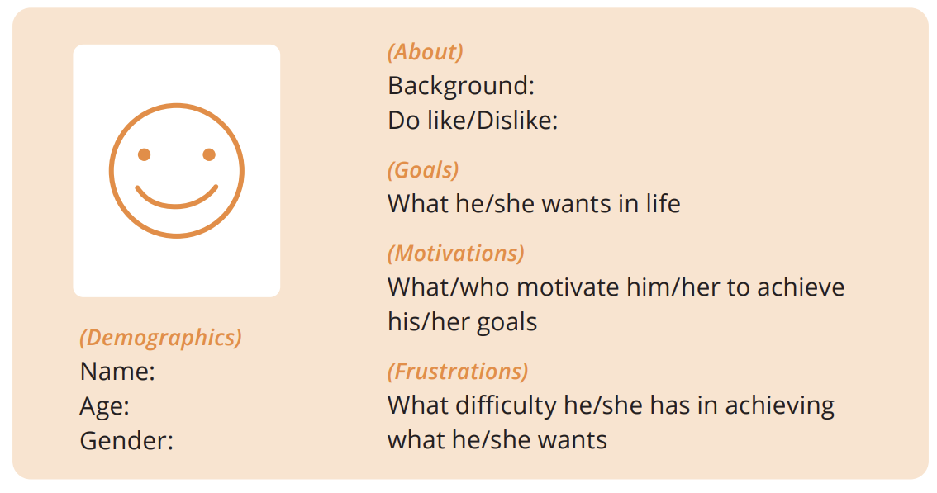
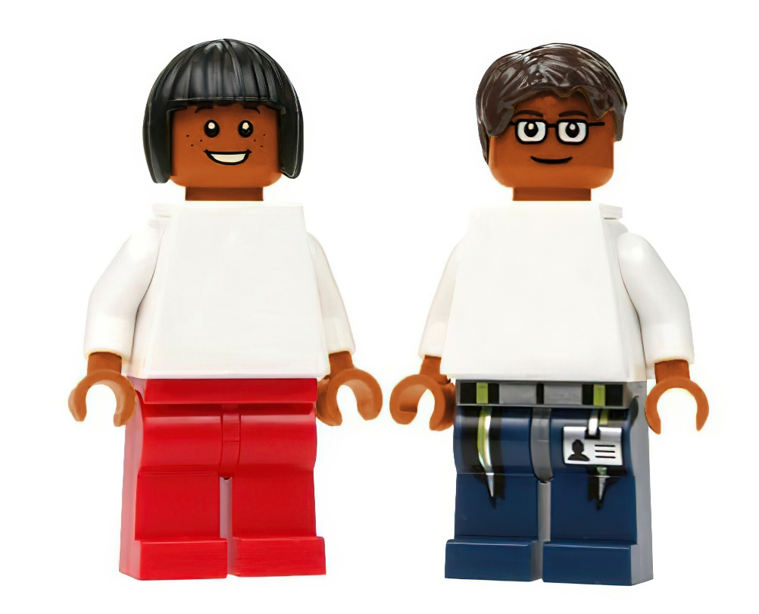
Build your target user’s profile as below:
PHASE 2: DESIGN | Activity 2-1
PERSONAS
Imagine something the persona would say to summarise their position on the problem, and write it as a quote.
Notes:
WHy do we build personas

Slide 56
Build your target user’s profile as below:
PHASE 2: DESIGN | Activity 2-1
PERSONAS
Isaac and Doreen - Suggest adding an example of persona – see the comment for proposed narrative
Imagine something the persona would say to summarise their position on the problem, and write it as a quote.
Notes:
WHy do we build personas

Slide 57
PHASE 2 : DESIGN | Activity 2-2
WHAT IS OUR
GOAL?
Solution Goal

Slide 58

PHASE 2: DESIGN | Activity 2-2
SOLUTION GOAL
“A challenge without a goal, is just a wish.”

Slide 59
PHASE 2: DESIGN | Activity 2-2
SOLUTION GOAL
To focus on the most important causes and define a goal while solving the problem.

Slide 60
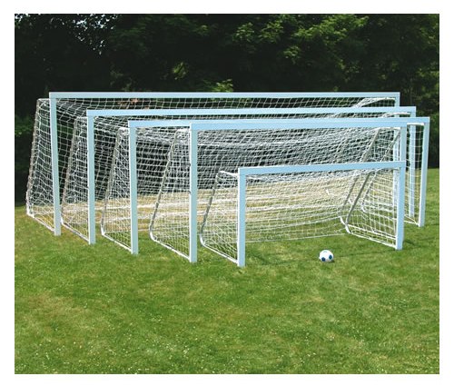
PHASE 2: DESIGN | Activity 2-2
SOLUTION GOAL
Why 1?
Start with the roots of the ‘Problem Tree’ and the causes identified using the ‘5 Whys’ activity.
Why2?
Why3?
Why 4?
Why 5?
Notes:
Dont go too broad or too small.

Slide 61
PHASE 2: DESIGN | Activity 2-2
SOLUTION GOAL
Why 1?
Your ‘Solution Goal’ is based on your choice of the cause you want to address as a problem solver.
Choose causes that you think is most important.
Why2?
Why3?
Why 4?
Why 5?
Notes:
Dont go too broad or too small.

Slide 62
PHASE 2: DESIGN | Activity 2-2
SOLUTION GOAL
(Solve Problem) for (Target Group) by (Addressing Chosen Cause)

Slide 63
What’s the goal
Start with the roots of the Problem Tree and the causes identified using the 5 WHYS activity.
- Go through all the causes
Question example
Why is there increased draught? One reason is because there’s hotter atmospheric temperature
Why is there hot temperature? One reason is because they generate electricity by burning fossil fuels and also carbon dioxide gas emissions from transport
Why transportation carbon dioxide gas emissions? Because 94% of fuel used in transportation is petroleum based
Why petroleum fuel? One reason is because most of the transport means are designed to consume fuel due to its high energy value per unit volume
Why do manufacturers choose to make petroleum fuel vehicles? One reason is because the electric vehicle (EV) industry is still in it’s early technology stage
SOLUTION GOAL
Stop drivers from causing Draught by getting them to use electric vehicles without releasing dangerous carbon emissions into the atmosphere
BUSINESS SOLUTION
Reduce draught by providing electric engines for transportation that don’t release dangerous carbon emissions into the atmosphere
Frame your Solution Goals

Slide 64
PHASE 2: DESIGN | Activity 2-2
SOLUTION GOAL
(TARGET GROUP)
(PROBLEM)
Stop Drivers from Causing drought by getting them to use electric vehicles without releasing dangerous carbon emissions into the atmosphere .
(CHOSEN CAUSES)

Slide 65
PHASE 2 : DESIGN | Activity 2-3
WHAT IS THE
CHALLENGE?
‘How Might We’ Challenge Statements

Slide 66
PHASE 2: DESIGN | Activity 2-3
CHALLENGE STATEMENTS
Once we have set our goal, there are many ways to reach it...

Slide 67
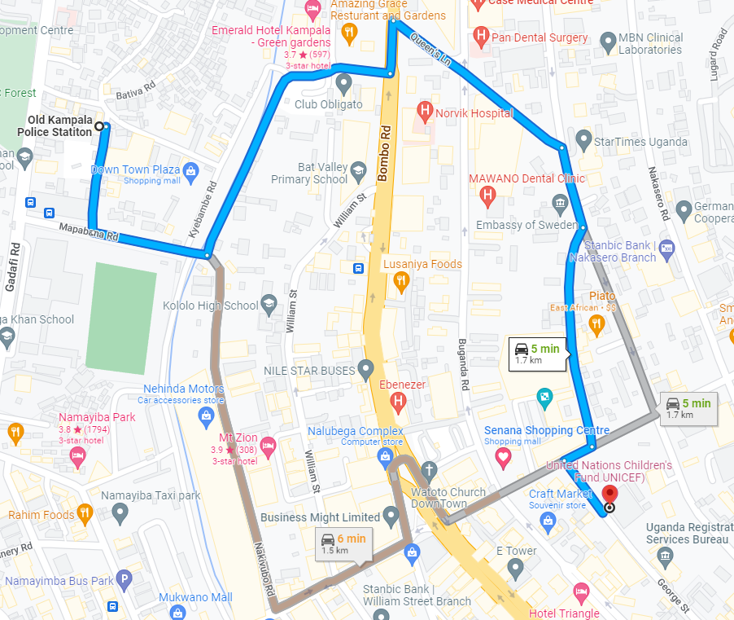
PHASE 2: DESIGN | Activity 2-3
CHALLENGE STATEMENTS
ROUTE 1
ROUTE 3
ROUTE 2
GOAL.
Notes:
Explain that A solution summa to take the first step in moving from an idea to something that can be implemented.

Slide 68
PHASE 2: DESIGN | Activity 2-3
CHALLENGE STATEMENTS
We use ‘How Might We’ questions to challenge ourselves to look at the different ways to reach our goal.

Slide 69
PHASE 2: DESIGN | Activity 2-3
CHALLENGE STATEMENTS
GOAL.
Stop drivers from causing drought by getting them to use electric vehicles without releasing dangerous carbon emissions into the atmosphere

Slide 70
PHASE 2: DESIGN | Activity 2-3
CHALLENGE STATEMENTS
ROUTE 1
How Might We… Get drivers adopt to use electric vehicles while spending lesser than petroleum cars?
GOAL.
Stop drivers from causing drought by getting them to use electric vehicles without releasing dangerous carbon emissions into the atmosphere
ROUTE 2
How Might We… get drivers use an alternative liquid that doesn’t cause negative environmental effects?
ROUTE 3
How Might we… get drivers become environmental conscious?

Slide 71
PHASE 2: DESIGN | Activity 2-3
CHALLENGE STATEMENTS - EXERCISE
Write many ‘How Might We’ Challenge Statements to generate different kinds of ideas and solutions to reach your goal.

Slide 72
PHASE 2 : DESIGN | Activity 2-4
BRAINSTORMING IDEAS
Brainstorming Tools

Slide 73
PHASE 2: DESIGN | Activity 2-4
BRAINSTORMING IDEAS
Brainstorming helps problem solvers come up with many ideas.

Slide 74

The more number of ideas there are - better the chance that great ideas and solutions will be found.

Slide 75

PHASE 2: DESIGN | Activity 2-4
BRAINSTORMING IDEAS
ROUTE 1
How Might We… get students to wash or clean hands without using water?
Idea 9
Idea 2
Idea 4
Idea 1
Idea 100
Idea 3
The goal isn’t to create a full or perfect solution; big and small ideas are welcome.
Idea 7
Idea 6
Idea 5

Slide 76
Idea 2
Idea 7
PHASE 2: DESIGN | Activity 2-4
BRAINSTORMING IDEAS
Idea 9
Idea 1
Idea 100
Idea 3
Idea 4
ROUTE 1
Idea 6
Idea 2
Idea 9
Idea 5
How Might We… Get drivers adopt to use electric vehicles while spending lesser than petroleum cars?
Idea 4
Idea 2
Idea 9
Idea 1
Idea 100
Idea 3
Idea 4
Idea 100
ROUTE 2
Idea 7
Idea 6
Idea 3
Idea 5
How Might We… get drivers use an alternative liquid that doesn’t cause negative environmental effects?
Idea 5
Idea 6
Idea 2
Idea 9
Idea 2
Idea 9
Idea 4
Idea 4
Idea 1
Idea 100
ROUTE 3
Idea 3
Idea 100
Idea 3
How Might We… get drivers become environmental conscious?
Idea 7
Idea 6
Idea 5
Idea 6
Idea 5

Slide 77


Slide 78

Notes:
Re-emphasize the goal of brainstorming—to generate as many creative ideas as possible—and its value—it gives us lots of ideas to work with.

Slide 79
Brainstorming Principle 1:
Do not judge your ideas at this stage.
Notes:
WHY?
(Experience share from core mentors)

Slide 80
Brainstorming Principle 2:
Come up with lots of ideas.
Notes:
WHY?
(Experience share from core mentors)

Slide 81
Brainstorming Principle 3:
After done with the individual idea generation, build ideas as a team.
Notes:
WHY?
(Experience share from core mentors)

Slide 82
Brainstorming Principle 4:
Focus and encourage
1 conversation at a time.
Notes:
WHY?
(Experience share from core mentors)

Slide 83
Brainstorming Principle 5:
Iterate!
Notes:
WHY?
(Experience share from core mentors)

Slide 84
Brainstorming Principle 6:
Record everything!
Notes:
WHY?
(Experience share from core mentors)

Slide 85

PHASE 2: DESIGN | Activity 2-4
BRAINSTORMING IDEAS
ROUND 1 - 5 MINUTES
First Idea + Crazy Idea
What is the first idea that comes to mind? What is a crazy idea that comes to mind?

Slide 86
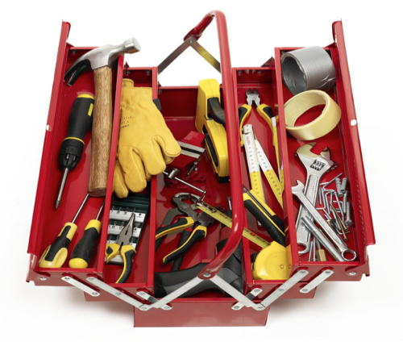
PHASE 2: DESIGN | Activity 2-4
BRAINSTORMING IDEAS
ROUND 2 - 15 MINUTES
Open Brainstorming
Any and every idea that comes to mind. Use your ‘How might we?’, personas and problem trees to come up with many ideas.
Notes:
Re-emphasize the goal of brainstorming—to generate as many creative ideas as possible—and its value—it gives us lots of ideas to work with.

Slide 87

PHASE 2: DESIGN | Activity 2-4
BRAINSTORMING IDEAS
ROUND 3 - 15 MINUTES
What If…?
What if the idea…
Is an object or thing
A service or process
A person
An Interaction
A communication

Slide 88


PHASE 2: DESIGN | Activity 2-4
BRAINSTORMING IDEAS
ROUND 4 - 15 MINUTES
Brainstorm as your persona
What are ideas that helpful target audiences could come up with? For Example: What kind of ideas would children come up with? What idea would parents come up with?

Slide 89

PHASE 2: DESIGN | Activity 2-4
BRAINSTORMING IDEAS
ROUND 5 - 15 MINUTES
Combine Ideas
Which ideas are similar? Which ideas can be combined into one bigger, better idea?

Slide 90
Idea 6
Step 1. Which ideas are similar? Which ideas can be combined into one bigger, better idea?
Idea 6
Idea 2
Idea 9
Idea 4
Idea 100
Idea 1
Idea 3
Idea 100
Idea 5
Idea 6
Idea 9
Idea 2
Idea 4
Idea 1
Idea 1
Idea 3
Idea 6
Idea 2
Idea 9
Idea 7
Idea 4
Idea 9
Idea 5
Idea 100
Idea 3
Idea 2
Step 2. Try to formulate 3 combined ideas and also make it understandable.
Idea 2
Idea 5
Idea 6

Slide 91
PHASE 2 : DESIGN | Activity 2-5
WHAT IS THE SOLUTION?
Solution summary

Slide 92
PHASE 2: DESIGN | Activity 2-5
SOLUTION SUMMARY
Adding detail to ideas helps others understand them and provide better feedback.
Notes:
Explain that A solution summary is the first step in moving from an idea to something that can be implemented. It focuses on identifying actions, objects, people and places involved in the idea.

Slide 93
Combined Idea 1
Combined Idea 2
Combined Idea 3
Idea 9
Idea 2
Idea 9
Idea 9
Idea 2
Idea 2
Idea 4
Idea 4
Idea 4
Idea 1
Idea 100
Idea 100
Idea 3
Idea 3
Idea 3
Idea 7
Idea 5
Idea 6
Idea 6
Idea 5
Idea 5

Slide 94
PHASE 2: DESIGN | Activity 2-5
SOLUTION SUMMARY
What is the solution?
Who are the people involved?
Idea 9
Idea 2
Idea 4
What are different activities involved?
Where is this happening?
Idea 1
Idea 3
Idea 7
Idea 5
Combined Idea 1
What are the different objects involved?
Can you draw the solution

Slide 95
PHASE 2: DESIGN | Activity 2-5
SOLUTION SUMMARY
Goal statement:
Prevent school students from falling sick by getting them to wash their hands while conserving water.
What is the solution?
Germ Killer: Little bit of Water + Disinfectant. No need for soap. Saves water, cleans hands!
Who are the people involved?
Some to make the product, some to give to schools and some to see if kids use
What are different activities involved?
Children are given a small amount of germ killer before eating. Clean and wipe hands.
Where is this happening?
Making is happening at our (team’s) homes and use is happening at school
Idea 9
Idea 2
Idea 4
Idea 1
Idea 3
What are the different objects involved?
Germ killer for which we need clean water and some disinfectant (not too strong smell)
Can you draw the solution
Yes
Idea 7
Idea 5
Combined Idea 1

Slide 96
PHASE 2 : DESIGN | Activity 2-6
CO-CREATE WITH TARGET AUDIENCE.
User Feedback, Interviews

Slide 97
PHASE 2: DESIGN | Activity 2-6
USER FEEDBACK + INTERVIEWS
Collect feedback and work with others to create better solutions.

Slide 98
PHASE 2: DESIGN | Activity 2-6
USER FEEDBACK + INTERVIEWS
Here are a few questions you can ask your users:
Does the solution address the cause and problem?
Is the solution easy to understand? Would it be easy to use?
Which parts of the solution work well and Why? Which don’t work well and Why?
Do you have suggestions for us to improve the solution?
Feedback at this stage allows problem solvers to improve their ideas before they commit to prototyping.

Slide 99
PHASE 2: DESIGN | Activity 2-6
USER FEEDBACK + INTERVIEWS
Example:
Potential Solution: XXXX
What do I need to find out: XXXX
Questions to ask to respective users:
Current users/customers
What is the main thing you look for in this product or service?
What makes or would make you choose this one over others?
What makes you choose a shop over others for this product?
How often do you buy this product or service?
How much are you willing to pay for it?
How could I convince customers to choose me over competitors?
Suppliers
What products or services can you offer me for my business idea?
Do you deliver or do I have to come pick these products at your store?
What makes your products or services better than those from other suppliers?
Other solution
providers
What type of users is this provider serving? Do I want to serve the same types of users/customers, or are there other types I can focus on?
How did this provider organise their work? How do they deliver?
Are there any ideas from this provider useful for my solution?
How will I differentiate myself from them? (Innovation/ Added value)

Slide 100
PHASE 3
BUILD + TEST /
START YOUR BUSINESS

Slide 101
PHASE 3: BUILD + TEST / START YOUR BUSINESS
Testing key elements of your solutions by building them quickly and reworking them based on user feedback.

Slide 102
PHASE 3: BUILD + TEST / START YOUR BUSINESS | Activity 3-1
WHAT IS THE
BEST SOLUTION?
Choose solutions

Slide 103
PHASE 3: BUILD + TEST / START YOUR BUSINESS | Activity 3-1
WHAT IS THE BEST SOLUTION?
Choose the best solution based on your learnings from testing your ideas with users.
Notes:
Explain to the teams that identifying the enablers (what works) and disablers (What doesn't) in relation to your idea will help them plan for possible setbacks in building and testing your solutions.

Slide 104
PHASE 3: BUILD + TEST / START YOUR BUSINESS | Activity 3-1 | CHOOSE SOLUTION
1. Identifying Positives and Negatives of Ideas
Example:
1
List your solutions on one side.
Goal Statement:
Prevent school students from falling sick by getting them to wash their hands while conserving water.
WHAT WORKS?
WHAT DOESN’T WORK?
2
Based on the feedback write down what works well for the solutions.
SOLUTION 1
Germ Killer Water
Building the right tools to dispense the germ killer water
Lack of clean water supply
Then, as a last step write down what doesn’t work well for the solutions.
SOLUTION 2
Campaign about hygienic practices
Local organization helping the children build materials for the campaign
Lack of support from schools
Campaign not enough
3
SOLUTION 3
Better use of limited water
Support from school faculty and staff to regulate water use
No one to control
4
Choose the solution that has more positives than negatives.

Slide 105





PHASE 3: BUILD + TEST / START YOUR BUSINESS | Activity 3-1 | CHOOSE SOLUTION
2. Micro-Screening of Ideas
Very good or positive
Good or reasonable
Indifferent
Put as many smiling, indifferent or sad faces as necessary, depending on the extent to which that criterion is satisfied. The solution that receives the most smiling faces is judged the most feasible.
Difficult or negative
Very difficult or negative
Access to resources (Human and material)
Added value compared to other providers
TOTAL score
Skills & Competencies
Equipment Availability
Financial resources
User/community needs
SOLUTION 1
Germ Killer Water
SOLUTION 2
Campaign about hygienic practices
SOLUTION 3
Better use of limited water

Slide 106
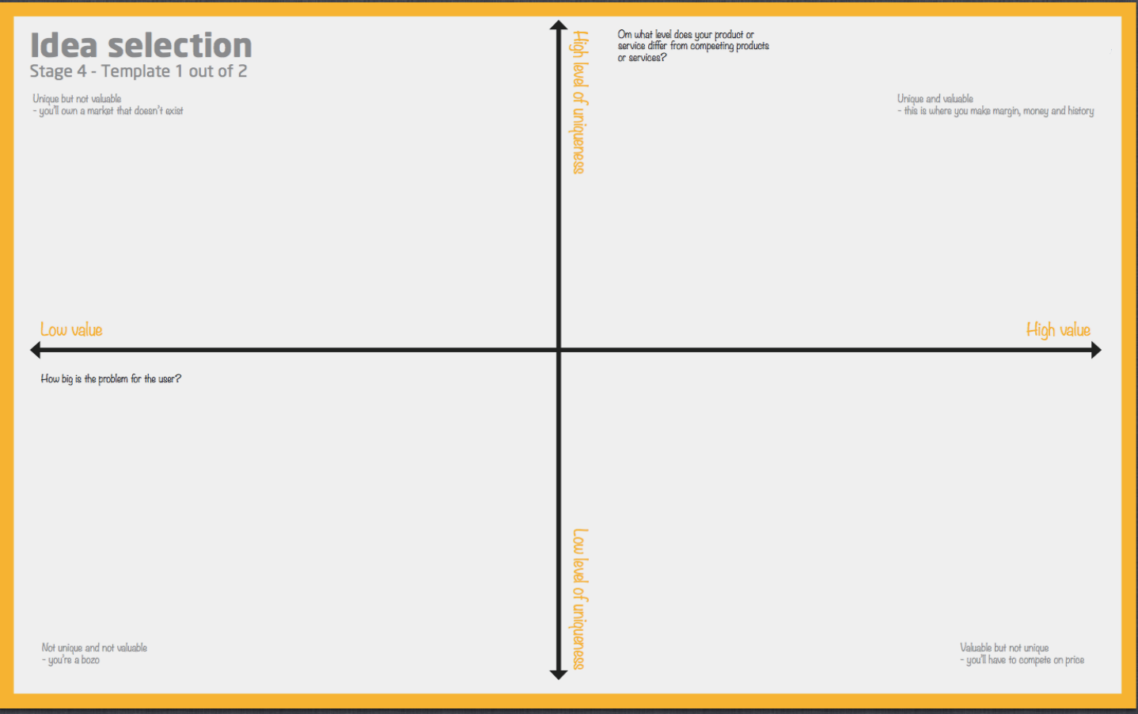

Slide 107
PHASE 3: BUILD + TEST / START YOUR BUSINESS | Activity 3-2
HOW DO I BUILD
MY SOLUTION?
Prototyping Methods

Slide 108
PHASE 3: BUILD + TEST | START YOUR BUSINESS | Activity 3-2
PROTOTYPING METHODS
Identifying and utilizing prototyping techniques in order to quickly build ideas.

Slide 109
PHASE 3: BUILD + TEST / START YOUR BUSINESS | Activity 3-2
PROTOTYPING METHODS
WHY DO WE PROTOTYPE ?
Build to
clarify the
idea.
Communicate
to show, not tell.
Test to
reduce
failure and
risk.

Slide 110
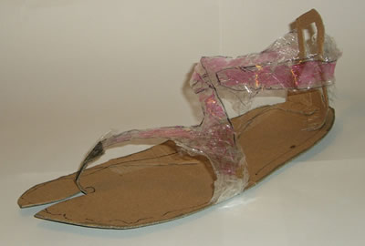
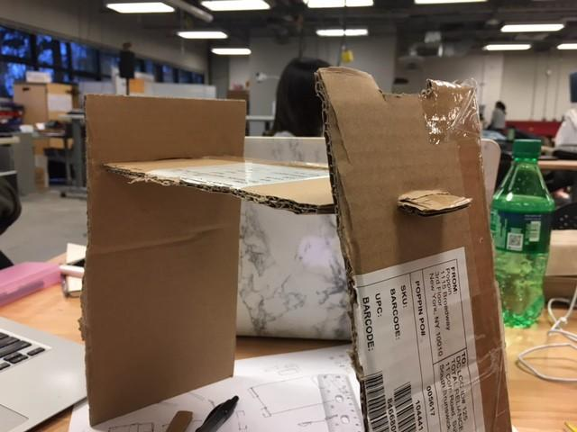
PHASE 3: BUILD + TEST / START YOUR BUSINESS | Activity 3-2
PROTOTYPING METHODS

Slide 111
PHASE 3: BUILD + TEST / START YOUR BUSINESS | Activity 3-2
PROTOTYPING METHODS
ROLEPLAYS FOR
INTERACTIONS
STORYBOARDS FOR SERVICES
PHYSICAL MODELS FOR PRODUCTS
PAPER PROTOTYPE FOR DIGITAL TOOLS
/ POSTERS ETC
Notes:
Explain to the team that Interaction is when people interact with one another, A service is any service the idea might provide, Digital tools are anything that uses technologies like mobile apps etc, products are any physical objects they might build.

Slide 112
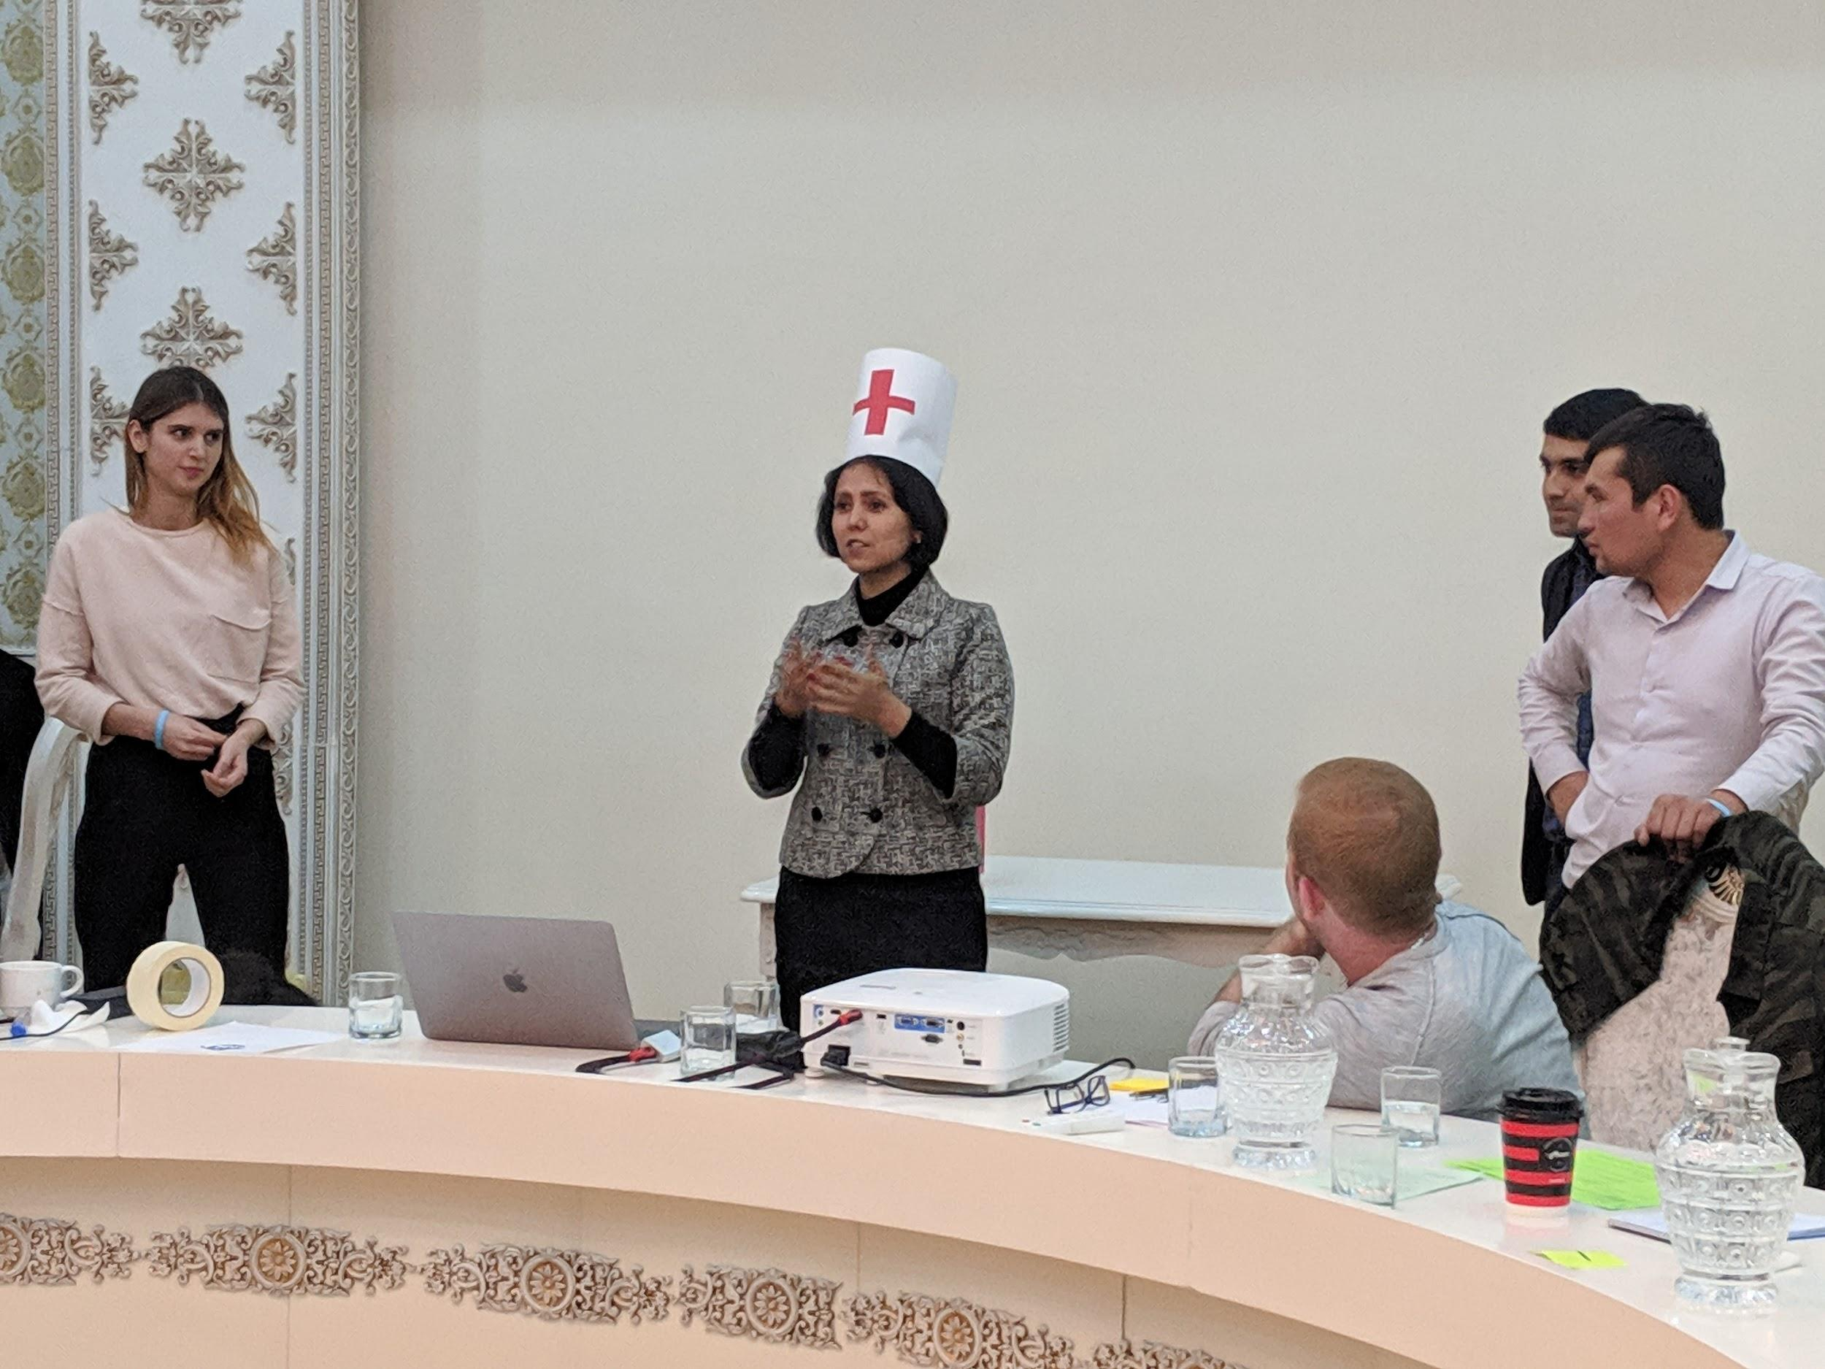
PHASE 3: BUILD + TEST / START YOUR BUSINESS | Activity 3-2 | PROTOTYPING METHODS
1. ROLEPLAY
ROLEPLAYS FOR
INTERACTIONS.
We use role play - a sort of skit or small play - to prototype interactions between people.
Notes:
Develop as many scenarios as possible for each persona you have developed. Remember to ask yourself how your solutions best meets the Personas needs?

Slide 113
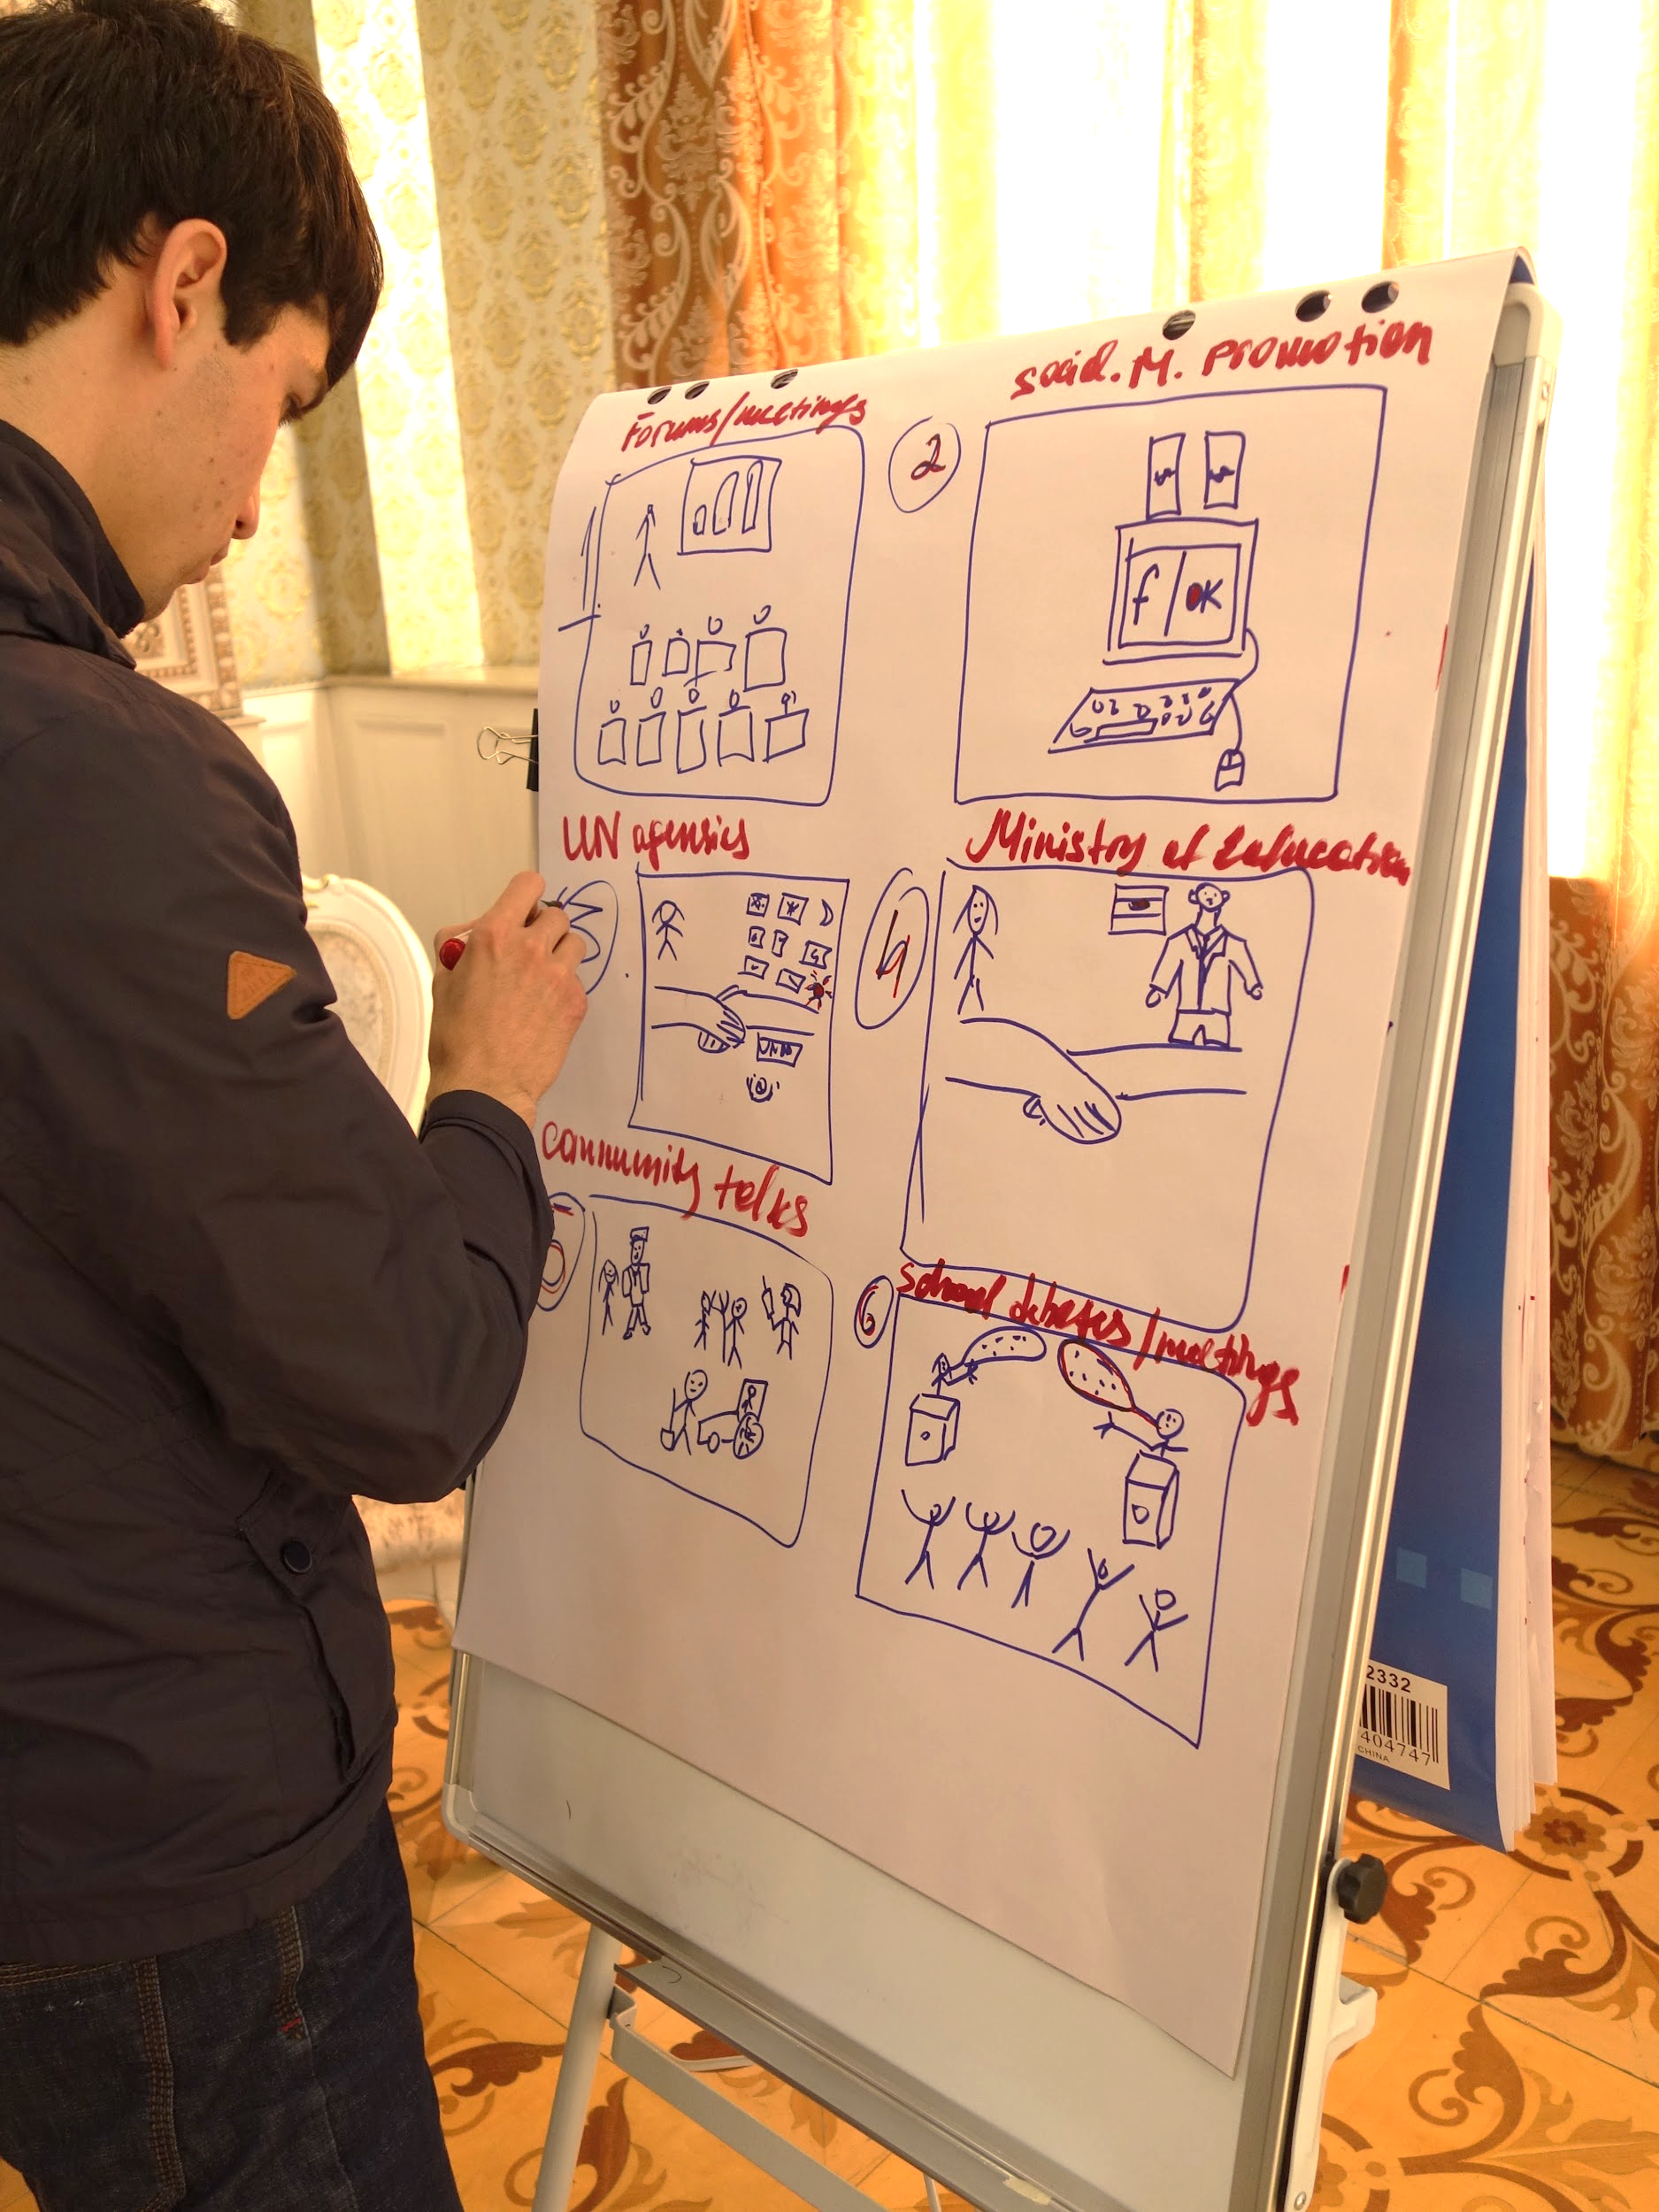
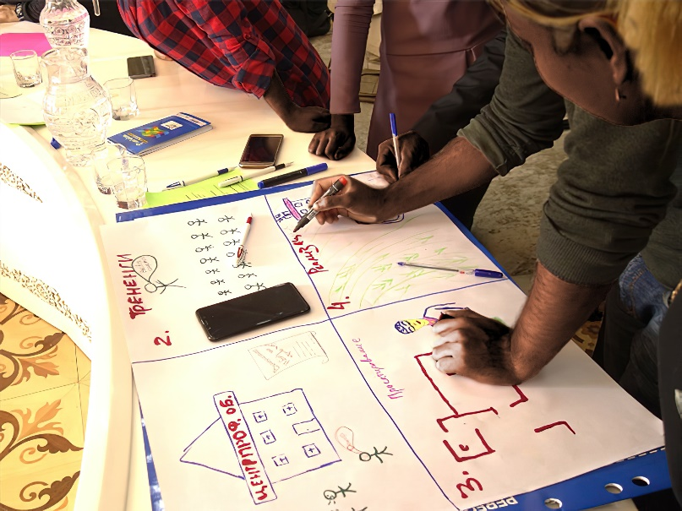
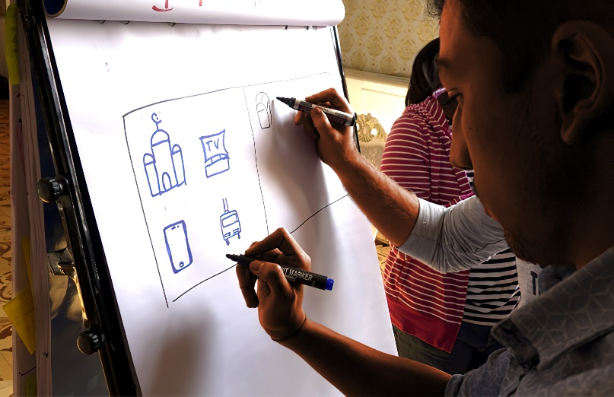
PHASE 3: BUILD + TEST / START YOUR BUSINESS | Activity 3-2 | PROTOTYPING METHODS
2. STORYBOARDS
STORYBOARDS FOR SERVICES.
Story Boards should be more specific, and try to map out every step of that component.
Notes:
Develop as many user journeys as possible for each persona you have developed. Remember to ask yourself how your solutions best meets the Personas needs?

Slide 114
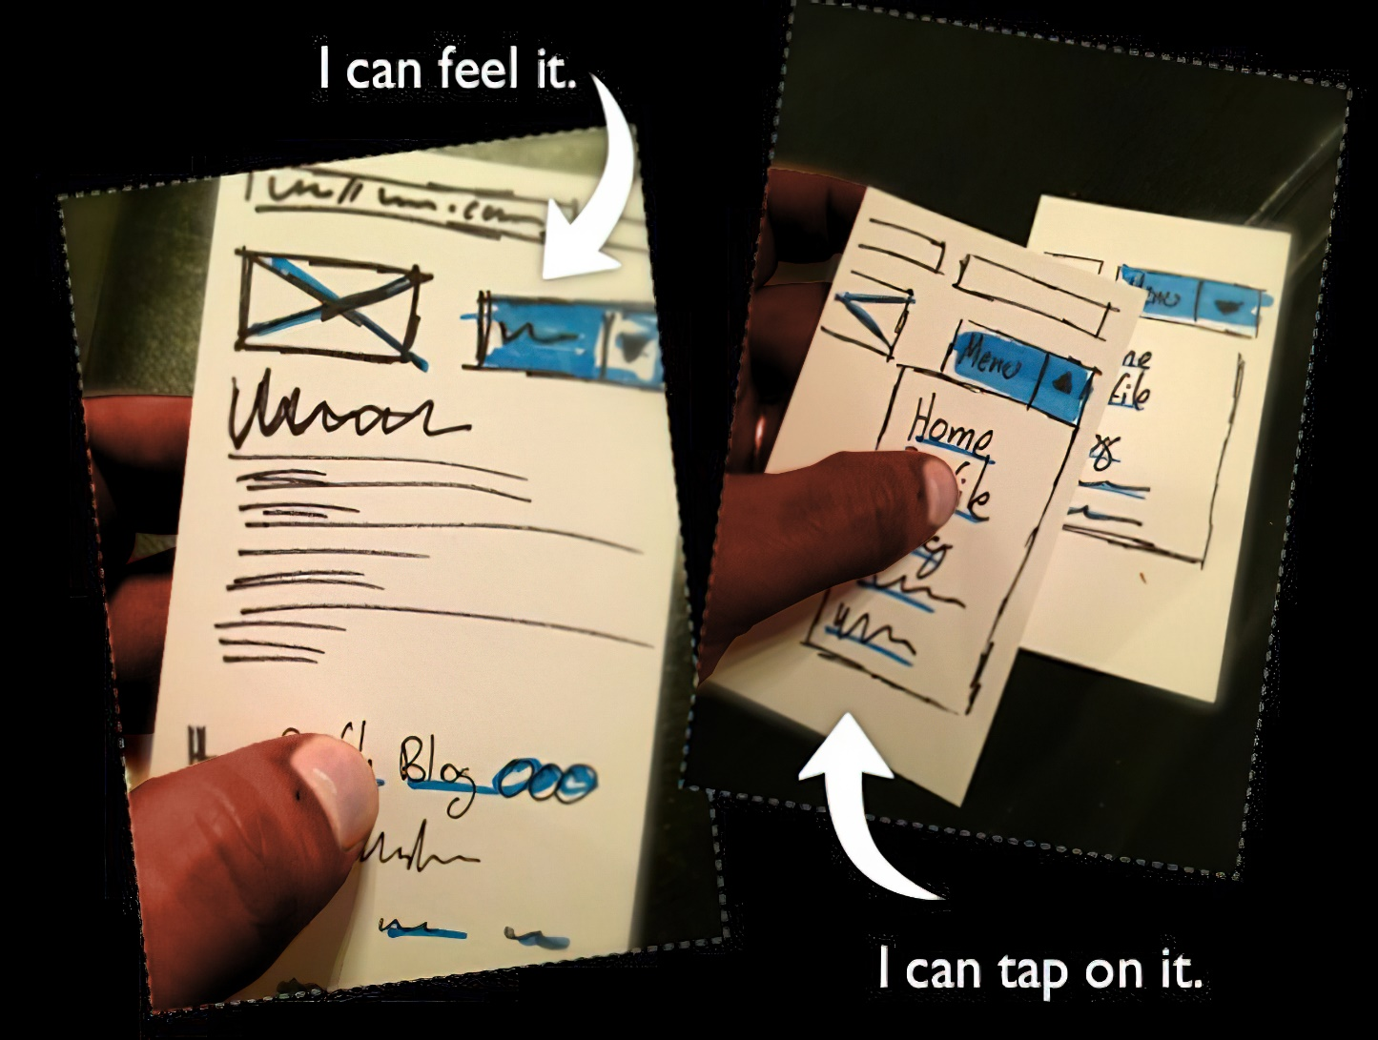
PHASE 3: BUILD + TEST / START YOUR BUSINESS | Activity 3-2 | PROTOTYPING METHODS
3. PAPER PROTOTYPE
PAPER PROTOTYPE FOR DIGITAL TOOLS / POSTERS ETC.
Paper Prototypes let us test designs that would require technical expertise and time to build.
Notes:
Develop as many user journeys as possible for each persona you have developed. Remember to ask yourself how your solutions best meets the Personas needs?

Slide 115
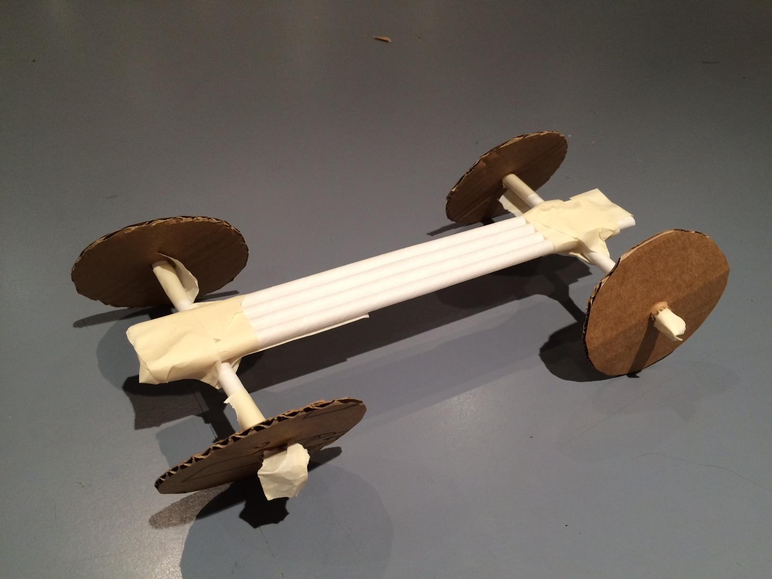
PHASE 3: BUILD + TEST / START YOUR BUSINESS | Activity 3-2 | PROTOTYPING METHODS
4. PHYSICAL MODELS
PHYSICAL MODELS FOR PRODUCTS.
Models don’t need to be fancy! They can can be built with found materials and let you explore the functionality of a product, and users’ interactions with it.

Slide 116
PHASE 3: BUILD + TEST / START YOUR BUSINESS | Activity 3-2
PROTOTYPING METHODS
What are the right prototypes for your team? Think of at least 3 parts of your solution to test with target audiences.
Notes:
Tips
• Storyboards are always a good way to show how something will be used.
• Always keep the target audience in mind - what would they like to test?
• Prototypes must represent meaningful and important parts of the solution.
• Prototypes should be simple to understand and give feedback for. • Prototypes are not supposed to be perfect and beautiful; it is ok to be rough.

Slide 117
PHASE 3: BUILD + TEST / START YOUR BUSINESS | Activity 3-3
RAPID PROTOTYPING
Prototyping Methods

Slide 118
PHASE 3: BUILD + TEST / START YOUR BUSINESS | Activity 3-3
RAPID PROTOTYPING
Build multiple prototypes of the solution as quickly as possible to test with target audiences.
Notes:
Explain to the teams that Rapid prototyping is done so that problem solvers do not spend too much time trying to perfect a prototype and instead focus on testing different parts of the solution with their user group and to learn fast from their mistake.

Slide 119
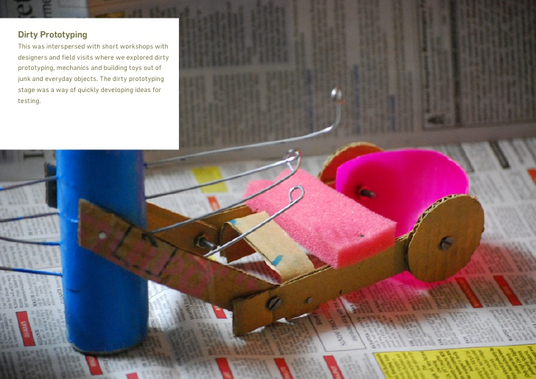
PHASE 3: BUILD + TEST / START YOUR BUSINESS | Activity 3-3
RAPID PROTOTYPING
REMEMBER!
a. Prototypes don't have to be perfect. Don't get bogged down in the colors, in the specific wording, etc.
b. Prototyping is iterative : we create a thing, test it, learn from it, and then re - build a better version!

Slide 120
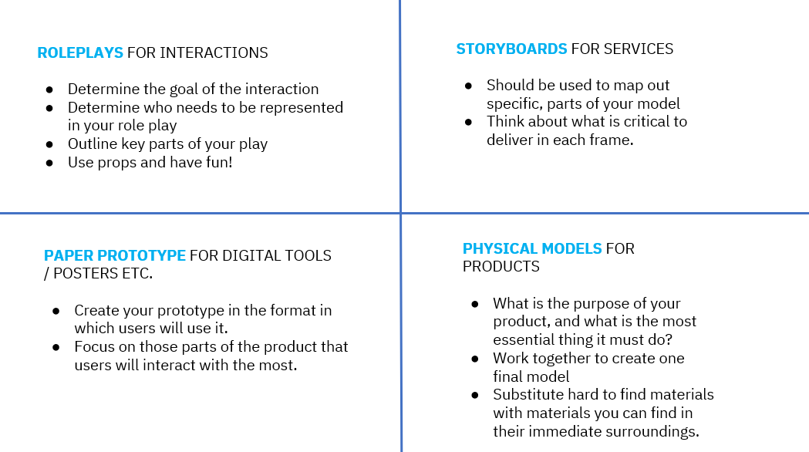
PHASE 3: BUILD + TEST / START YOUR BUSINESS | Activity 3-3
RAPID PROTOTYPING
How and what do you want to prototype?

Slide 121
PHASE 3: BUILD + TEST / START YOUR BUSINESS | Activity 3-3
RAPID PROTOTYPING - EXERCISE
Build at least 3 rapid prototypes of the chosen solution.
You can prototype different elements of one idea, or prototype different ideas altogether using some or all of the prototyping methods.
Notes:
Explain to the teams that Rapid prototyping is done so that problem solvers do not spend too much time trying to perfect a prototype and instead focus on testing different parts of the solution with their user group and to learn fast from their mistake.

Slide 122
PHASE 3: BUILD + TEST / START YOUR BUSINESS | Activity 3-4
TEST PROTOTYPES WITH TARGET USERS
USER TESTING + FEEDBACK

Slide 123
PHASE 3: BUILD + TEST / START YOUR BUSINESS | Activity 3-4
USER TESTING
Test prototypes with users to improve solutions by learning what works and what doesn’t.
Notes:
Explain that user testing means letting the target audience interact with the prototype and provide feedback. Once there is a prototype a user does not need to imagine the solution - it becomes more obvious to them and they are able to provide better feedback.

Slide 124
PHASE 3: BUILD + TEST / START YOUR BUSINESS | Activity 3-4
USER TESTING
Here are a few questions you can ask your users:
Does the prototype help the user understand the solution proposed?
Do you have suggestions for us to improve the prototype?
Do you have suggestions for us to improve the overall solution?
Does the prototype help you decide if you want to use this solution?
In order to understand whether your prototype works and what changes might make it work better, it's helpful to build a plan to gather feedback
Notes:
Have the team reflect on what questions they may have about how users will engage with their prototype. Is there anything they worry might not work? Anything they worry users won't understand? Have the team work together to identify questions they want to ask during an interview with users beyond the 4 prompts provided

Slide 125
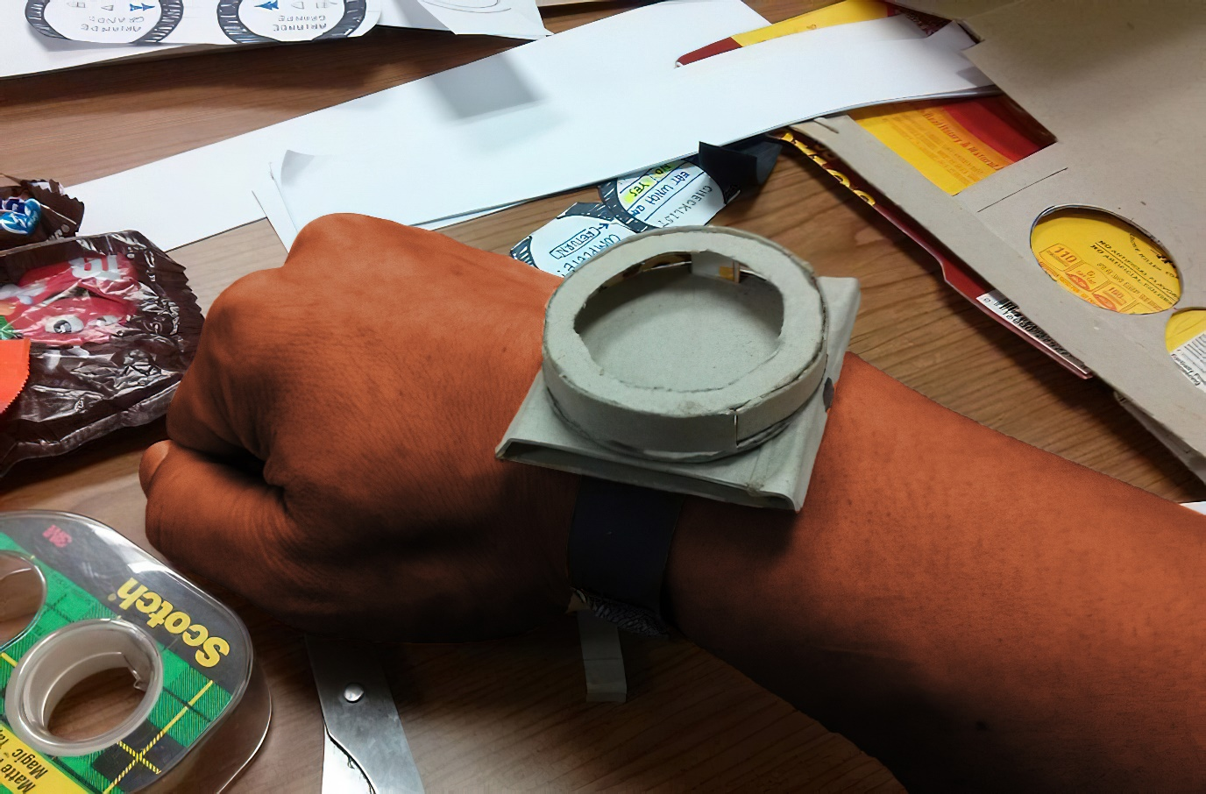
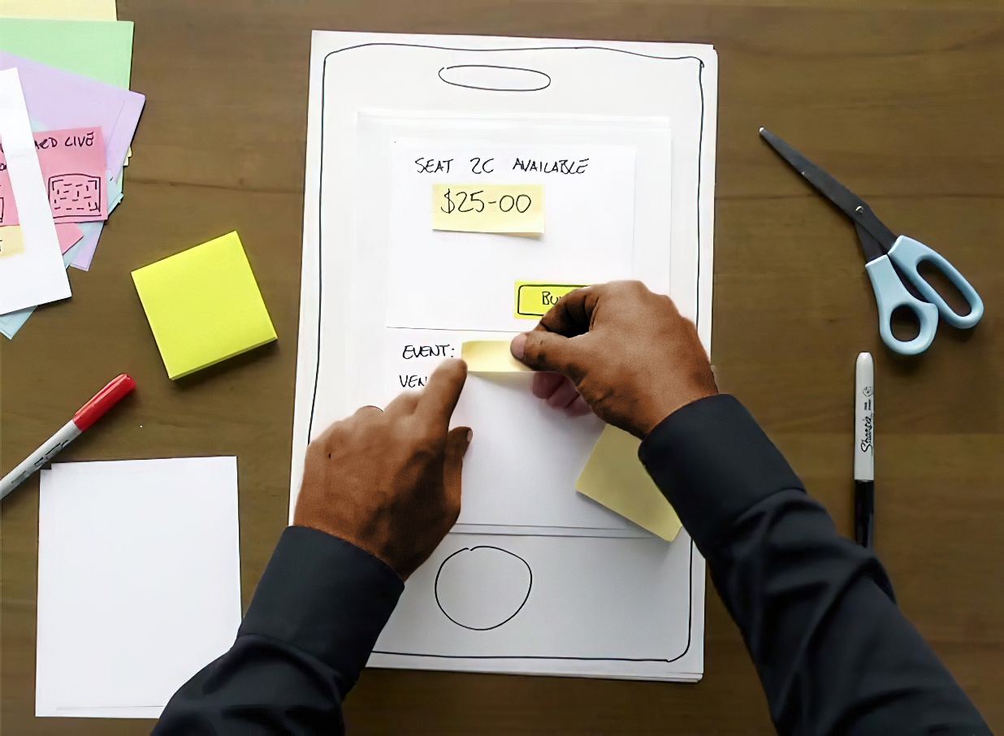
PHASE 3: BUILD + TEST / START YOUR BUSINESS | Activity 3-4
USER TESTING

Slide 126
PHASE 4
MAKE IT REAL

Slide 127
PHASE 4
MAKE IT REAL
Review solutions, identify resources needed, and prepare your project pitch.

Slide 128
PHASE 4
MAKE IT REAL
Now that you have a solution, it’s time to figure out how to make it sustainable..

Slide 129
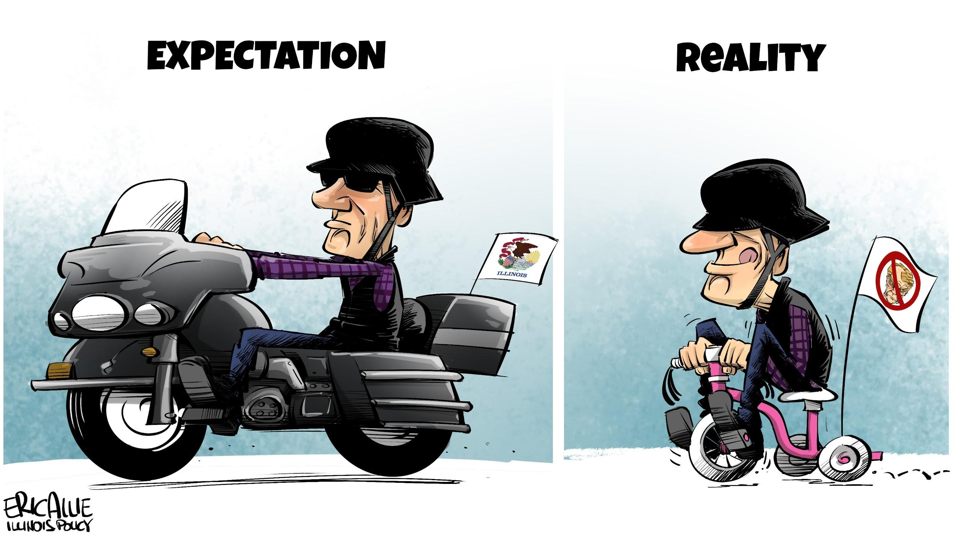
PHASE 4
MAKE IT REAL

Slide 130
PHASE 4: MAKE IT REAL | Activity 4-1
HOW CAN I PLAN MY RESOURCES?
Capabilities & Inputs

Slide 131
PHASE 4: MAKE IT REAL | Activity 4-1
CAPABILITIES & INPUTS
Identify resources needed for implementing solution - those already available and resources that need to be found.

Slide 132

PHASE 4: MAKE IT REAL | Activity 4-1
CAPABILITIES & INPUTS
CAPABILITIES
(What I already have!)
INPUTS
(What I lack?)
Notes:
The ‘Capabilities and Inputs’ Chart helps identify the different kinds of resources that are needed. ‘Capabilities’ are resourcing the team already has and ‘Inputs’ are new resources to be sourced from outside. Through this tool, problem-solvers can realize whether their solution is feasible or not. If not, then they can try and simplify their solution so that it can be feasible.

Slide 133
PHASE 4: MAKE IT REAL | Activity 4-1
CAPABILITIES & INPUTS
MATERIALS
Raw materials needed to build the final solution.
EQUIPMENT
Any machines or instruments needed.
PEOPLE
Skills and expertise needed by the team.
OTHER SUPPORT
Any other help such as space or permissions needed.

Slide 134

PHASE 4: MAKE IT REAL | Activity 4-1
CAPABILITIES & INPUTS

Slide 135
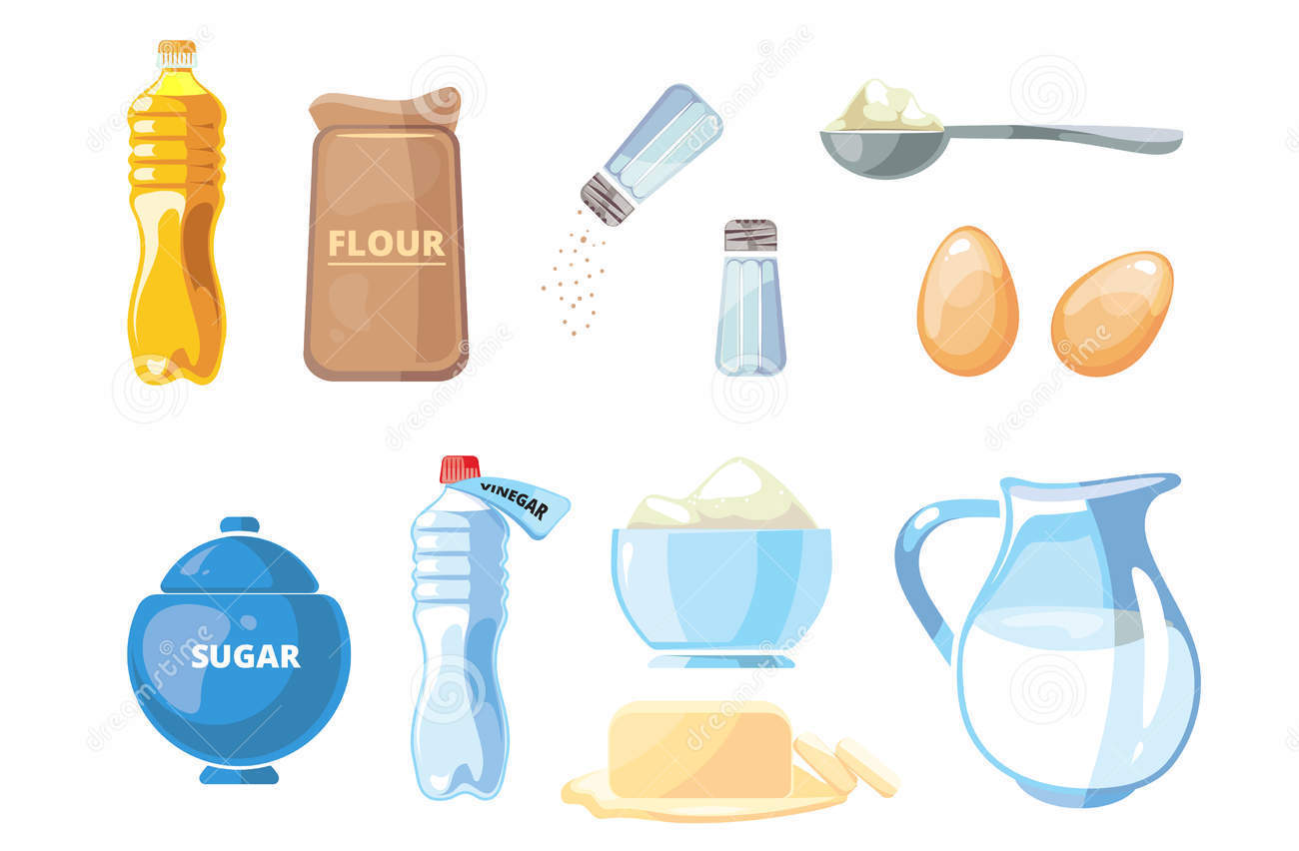

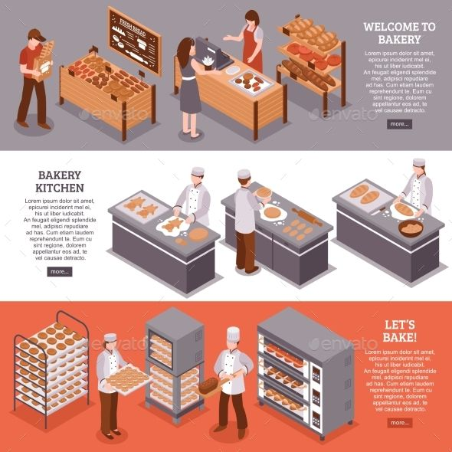
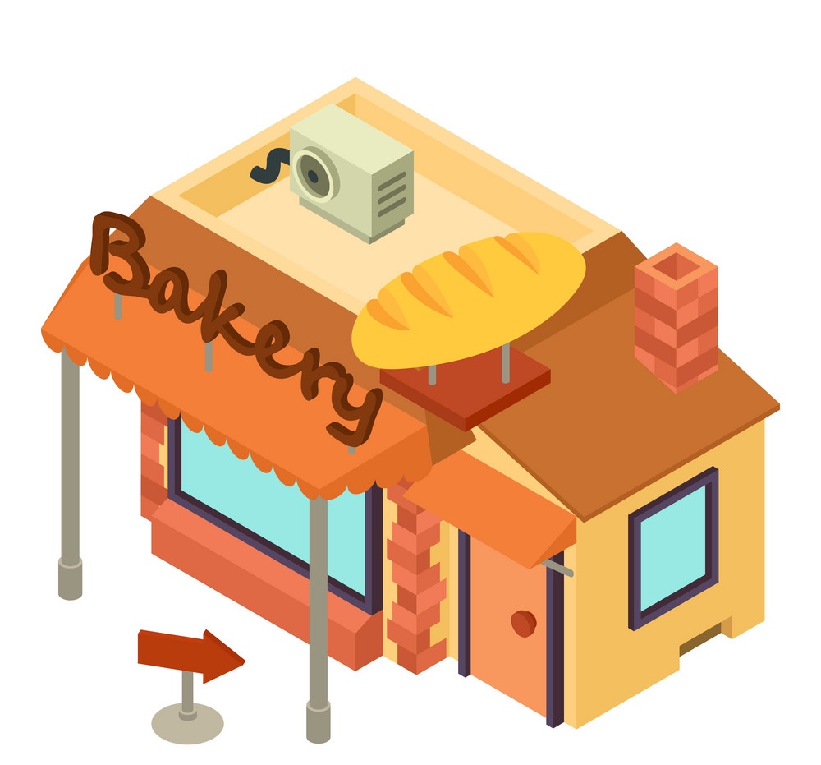
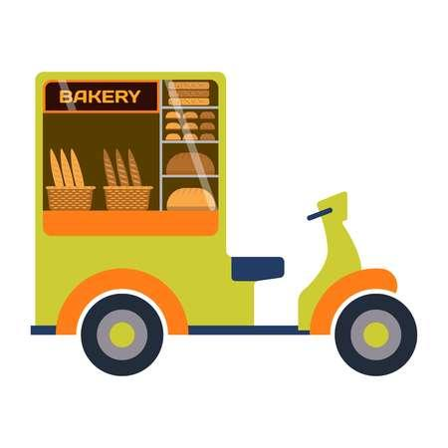
MATERIALS Raw materials needed to build the final solution.
EQUIPMENT Any machines or instruments needed.
PEOPLE Skills and expertise needed by the team.
OTHER SUPPORT Any other help such as space or permissions needed.

Slide 136
MATERIALS
EQUIPMENT
Item 1
Item 3
Item 1
Item 2
Item 2
HUMAN RESOURCES
SUPPORT
Item 3
Item 1
Item 1
Item 2
Item 2
Notes:
Activity Guide: Capabilities and Inputs Chart
Choose post-its of two different colours.
Make a list of the resources required.
Write each resource on the correct Post-it (Capabilities or Inputs) and put them in the relevant section
Note: Think of resources that you need to get started. What does the team need in the first 3 months? What will it need in 6 months, 1 year? What are the most essential resources?

Slide 137
PHASE 4 | MAKE IT REAL | Activity 4-1
CAPABILITIES & INPUTS
CAPABILITIES
(What I already have!) = FREE!
INPUTS
(What I lack?)
= $$$$!!
Notes:
Note: it is not necessary to identify costs at this stage, and even zero cost inputs should be included.
Note: The more ‘Inputs’ needed, the more difficult it may be to implement a solution. As a facilitator, try and help teams identify the right and appropriate amount of resources to get their
solution implemented. Remember that it is important that the solution is kept simple and focused on solving the problem for target audiences. Thinking small is important to begin with.

Slide 138
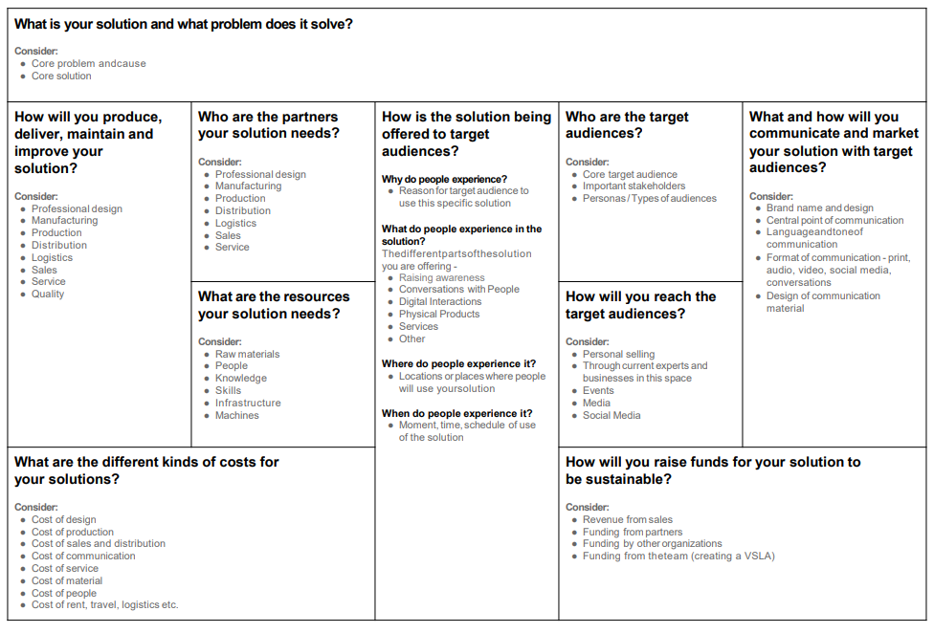
PHASE 4 | MAKE IT REAL | Activity 4-1
SOLUTION DEVELOPMENT CANVAS - Reference
Map out the key components of building a solution including users and how to reach users/resources required
(to be conducted in the beginning of Mentorship stage)

Slide 139
PHASE 4: MAKE IT REAL | Activity 4-2
HOW DO I RAISE FINANCES?
SUSTAINABILITY & REVENUE

Slide 140
PHASE 4: MAKE IT REAL | Activity 4-2
SUSTAINABILITY & REVENUE
Identify how budgets can be raised and managed for making the solution sustainable.
Notes:
Explain that, now that the team has designed a solution, the next step is to build a version of their solution to test it! The minimum viable product of a car? A skateboard!

Slide 141

PHASE 4: MAKE IT REAL | Activity 4-2
SUSTAINABILITY & REVENUE
The sustainability of an idea is reflective of a good solution.
Notes:
Check: Where is the Sustainability and Revenue chart?

Slide 142


PHASE 4: MAKE IT REAL | Activity 4-2
SUSTAINABILITY AND REVENUE
Think about... what can we charge for?
Regular fees or One time payment?
Notes:
Charging people

Slide 143
PHASE 4: MAKE IT REAL | Activity 4-2
SUSTAINABILITY AND REVENUE
Think about... can someone give us a donation?
Organizations and people who may want to help us?
Notes:
Getting a donation

Slide 144
PHASE 4: MAKE IT REAL | Activity 4-2
SUSTAINABILITY AND REVENUE
Think about... can we reduce costs?
Discounts or subsidies on the resources
Notes:
Reducing costs

Slide 145
PHASE 4: MAKE IT REAL | Activity 4-2
SUSTAINABILITY AND REVENUE
Think about... other ways to raise funds?

Slide 146
PHASE 4: MAKE IT REAL | Activity 4-2
SUSTAINABILITY AND REVENUE
To raise resources for your idea...
Consider stakeholders (looking at your stakeholder map from phase 1) who share your vision and might be interested in supporting you idea. i.e., Start-up capital
Look at other institutions that might adopt your project.
Look at aspects of your idea that could generate revenue i.e., be paid for (In most cases charging your target beneficiaries is not appropriate)
Identify stakeholders who might provide input at no costs, In kind contributions, such as technical assistance, services, volunteers or equipment.
Consider aspects of your idea that can continue without input.
Notes:
Think of funds in two ways - what do you need to get started? How will your solution continue to operate?

Slide 147
PHASE 4: MAKE IT REAL | Activity 4-3
WHAT IS THE FINAL SOLUTION?
WORKING WITH FEEDBACK

Slide 148
PHASE 4 MAKE IT REAL | Activity 4-3
WORKING WITH FEEDBACK
Take the prototype and solution to its final version based on learnings from feedback and resource planning.

Slide 149
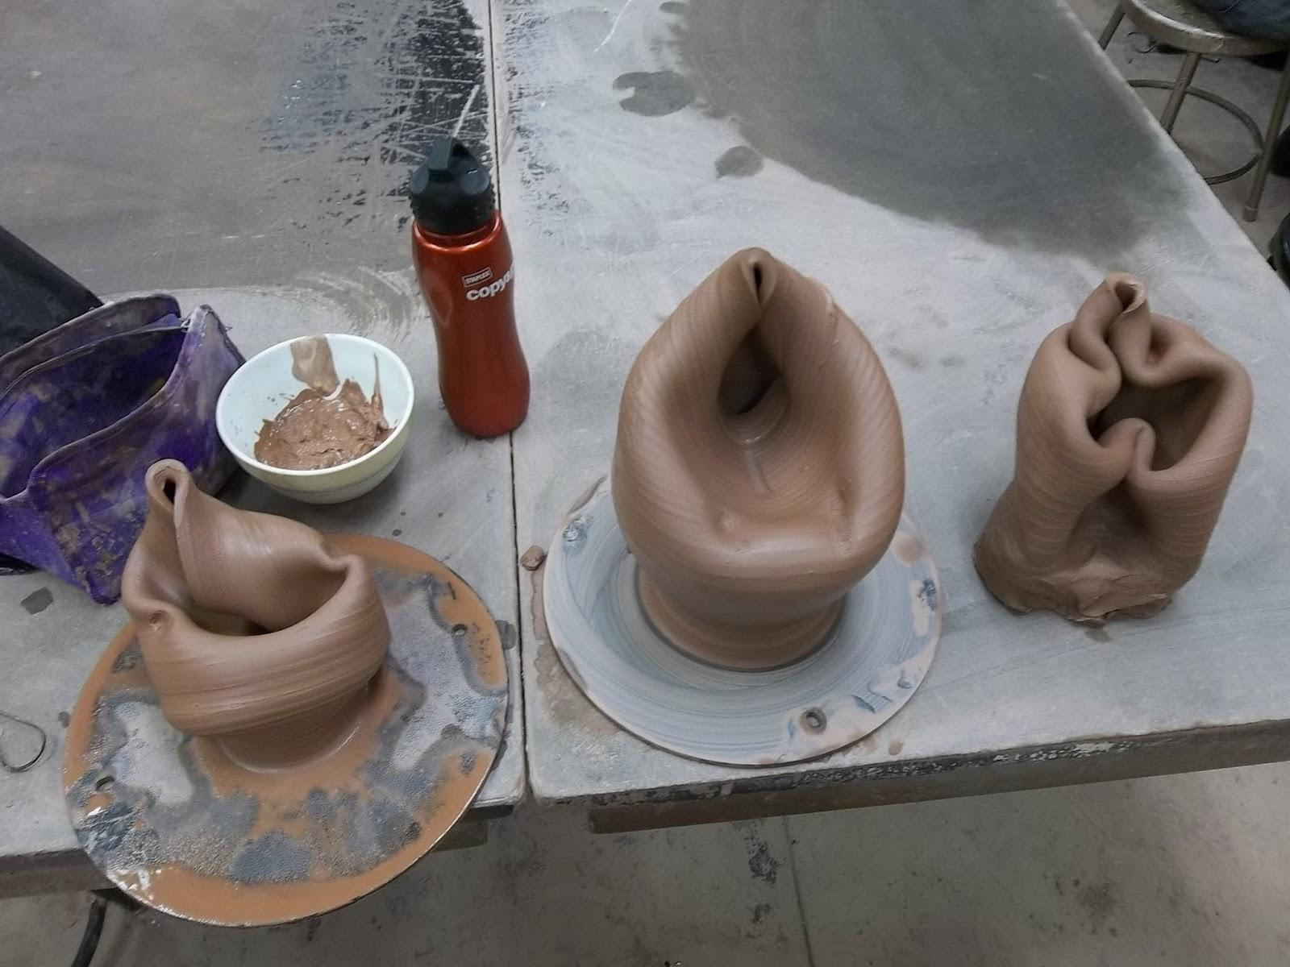
PHASE 4 MAKE IT REAL | Activity 4-3
WORKING WITH FEEDBACK
A good solution is usually perfected after many rounds of iteration.
Notes:
Explain that a potter goes through multiple rounds of iteration as he/she attempts to make the perfect pot,

Slide 150
PHASE 4: MAKE IT REAL | Activity 4-4
HOW CAN I SELL MY IDEA?
CRAFTING THE PITCH

Slide 151
PHASE 4 | MAKE IT REAL | Activity 4-4
CRAFTING THE PITCH
Create a short impactful presentation to share your solution with the judges.

Slide 152
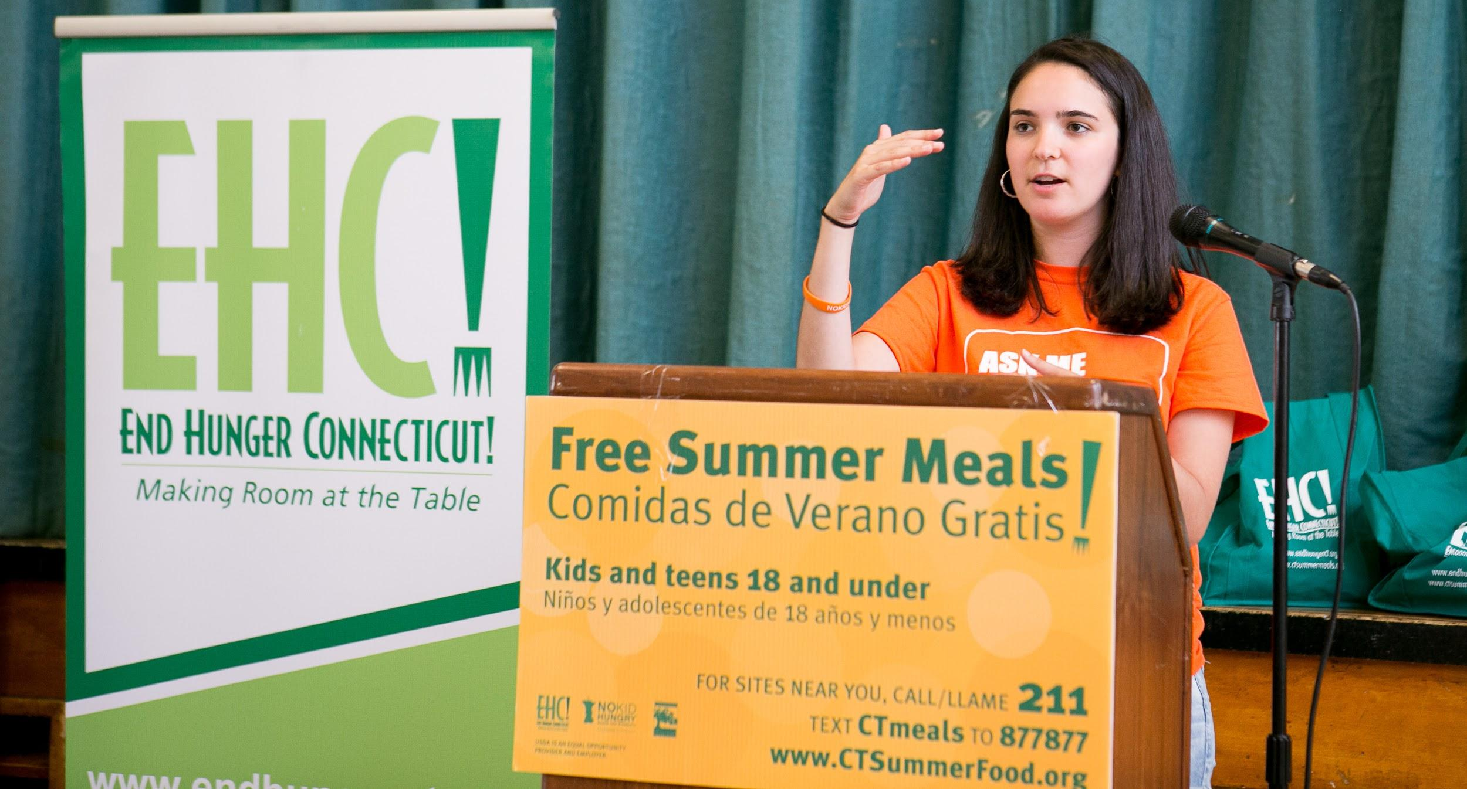
PHASE 4 MAKE IT REAL | Activity 4-4
CRAFTING THE PITCH
The ability to sell an idea depends on you can convince others about the effectiveness of your solution.

Slide 153

PHASE 4 MAKE IT REAL | Activity 4-4
WORKING WITH FEEDBACK
Once you have your solution, you need to be able to “Sell it” by conveying the most important aspects about your proposed solution to key stakeholders (investors, clients or consumers)
Notes:
Have to ensure we define what empathy is.

Slide 154
PHASE 4 | MAKE IT REAL | Activity 4-4
CRAFTING THE PITCH
Your pitch should communicate key aspects of your solution. But first don’t forget to name your idea!
THE PROBLEM | What is the larger problem you are trying to solve for? Explain the problem, who is impacts and how.
THE GOAL FOR SOLUTION & CHOSEN CHALLENGE | What was the ultimate goal of the solution? What was the specific challenge the team worked on?
THE SOLUTION + TARGET AUDIENCE | What is the final solution? Who is the chosen target audience? How does it solve the problem?
ADVANTAGE | What is your advantage? Highlight your uniqueness and advantages over existing alternatives.
RESOURCES & FINANCES | What resources and finances will be needed to execute?

Slide 155

Rules for a compelling pitch!
Keep your presentation succinct and short.

Slide 156

Rules for a compelling pitch!
Establish a connection to whom you are pitching & the problem.

Slide 157

Rules for a compelling pitch!
Show your passion and energy!

Slide 158
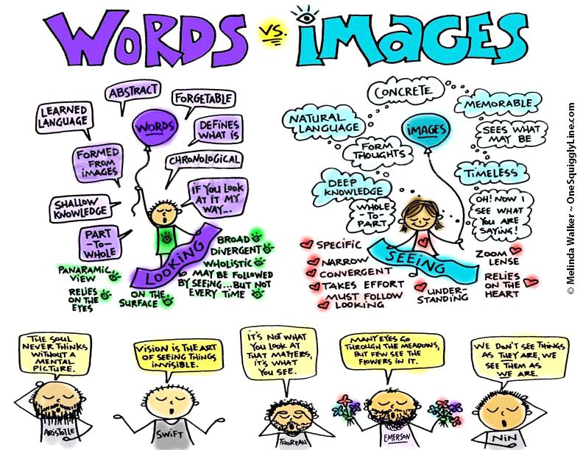
Rules for a compelling pitch!
Be visual!

Slide 159
PHASE 4 | MAKE IT REAL | Activity 4-4
CRAFTING THE PITCH
How you present your pitch is also an important tool to make your idea more persuasive. Here are a few tips to keep in mind:
Keep your presentation succinct - include vital information and keep it short.
Establish a connection between the person to whom you are pitching and the problem/solution. Convey authenticity.
Pitch clearly and with energy, show your passion. And practice!
Be visual.

